Slide 1
MS&E 228: Modern Non-Linear Prediction (Part II)
Vasilis Syrgkanis
MS&E, Stanford

Slide 2
Causal Inference with Experiments
Prediction with Linear Models
Prediction with High-Dim Linear Models
Inference on Causal and Predictive Effects with High-Dim Linear Models
Potential Outcomes and Conditional Ignorability
Structural Equation Models and Conditional Exogeneity
Directed Acyclic Graphs
Prediction with Non-Linear Models
Inference on Causal Effects with Non-Linear Models
Un-observed Confounding and Instruments
Identification of Causal Effects in Longitudinal Data
Estimation of Heterogeneous Causal Effects
Linear Predictive Models and Statistical Inference
Causal Identification in Observational Data
Non-Linear Predictive Models and Statistical Inference
Topics

Slide 3
Causal Inference with Experiments
Prediction with Linear Models
Prediction with High-Dim Linear Models
Inference on Causal and Predictive Effects with High-Dim Linear Models
Potential Outcomes and Conditional Ignorability
Structural Equation Models and Conditional Exogeneity
Directed Acyclic Graphs
Prediction with Non-Linear Models
Inference on Causal Effects with Non-Linear Models
Un-observed Confounding and Instruments
Identification of Causal Effects in Longitudinal Data
Estimation of Heterogeneous Causal Effects
Linear Predictive Models and Statistical Inference
Causal Identification in Observational Data
Non-Linear Predictive Models and Statistical Inference
Topics

Slide 4
Recap of Last Lecture

Slide 5

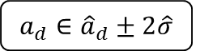

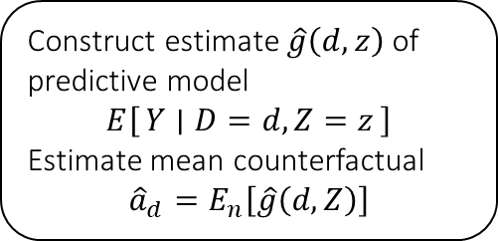

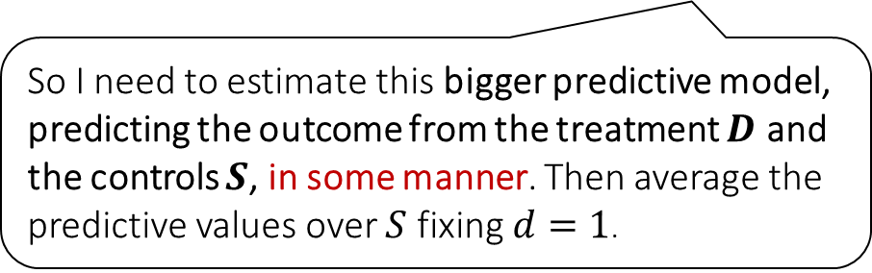
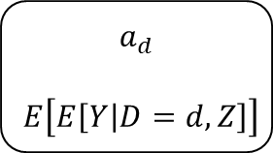

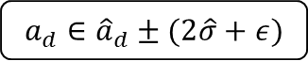
Causal Inference Pipeline
Data Collection
Estimation
(training)
Validation
(testing)
Domain Assumption Elicitation
Identification
Inference (Confidence Intervals)
DAGs/ASEMs
Construct estimate $\hat{g}\left(d,z\right)$ of predictive model
$$E\left[Y ∣ D=d,Z=z\right]$$
Estimate mean counterfactual
$${\hat{a}}_{d}=E_{n}\left[\hat{g}\left(d,Z\right)\right]$$
Theory
$$a_{d}$$
$$E\left[E\left[Y | D=d,Z\right]\right]$$
$$D$$
$$=$$
$$a_{d}∈{\hat{a}}_{d}±2\hat{σ}$$
$$Z$$
$$Y$$
So I need to estimate this bigger predictive model, predicting the outcome from the treatment $D$ and the controls $S$, in some manner. Then average the predictive values over $S$ fixing $d=1$.
Sensitivity Analysis
Practice
$$a_{d}∈{\hat{a}}_{d}±(2\hat{σ}+ε)$$
Adaptive Experiments
Decision
Policy

Slide 6
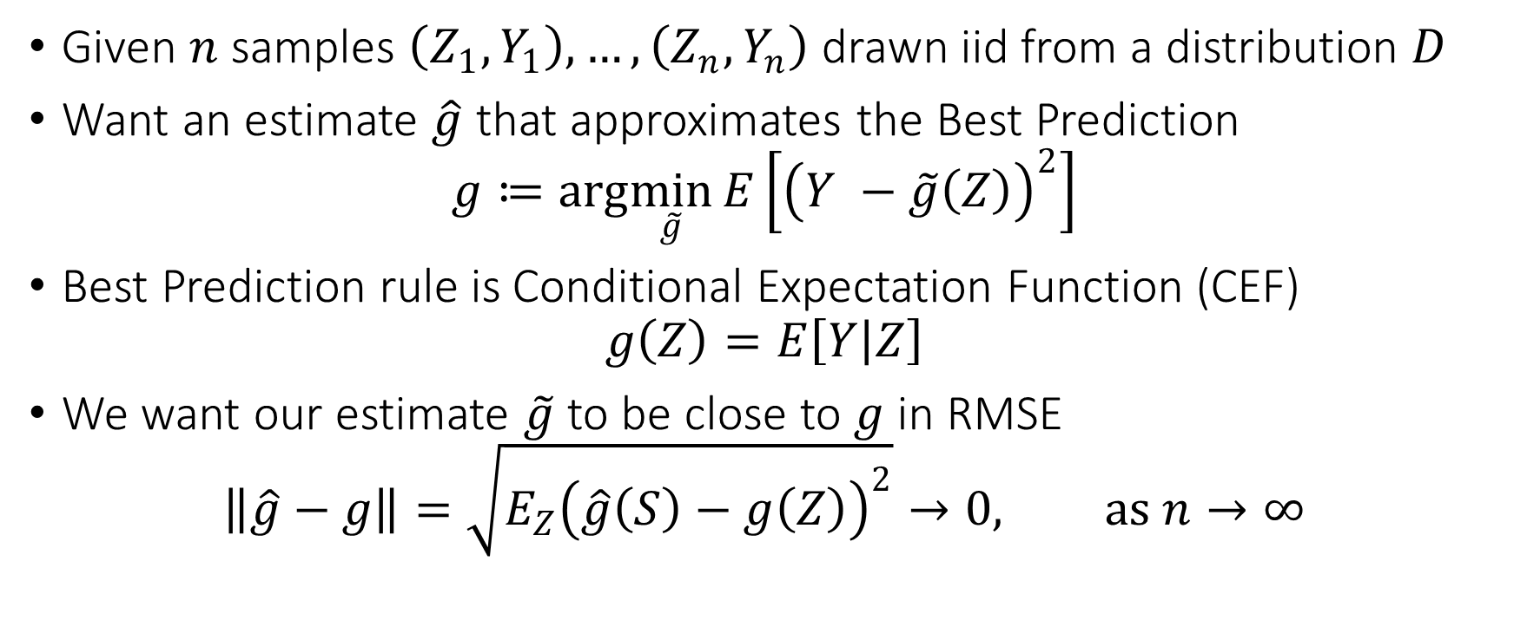
Problem Statement
Given $n$ samples $\left(Z_{1},Y_{1}\right),…,\left(Z_{n},Y_{n}\right)$ drawn iid from a distribution $D$
Want an estimate $\hat{g}$ that approximates the Best Prediction
$$g≔arg\min_{\tilde{g}}{E\left[{\left(Y −\tilde{g}\left(Z\right)\right)}^{2}\right]}$$
Best Prediction rule is Conditional Expectation Function (CEF)
$$g\left(Z\right)=E\left[Y | Z\right]$$
We want our estimate $\tilde{g}$ to be close to $g$ in RMSE
$$\left\|\hat{g}−g\right\|=\sqrt{E_{Z}{\left(\hat{g}\left(S\right)−g\left(Z\right)\right)}^{2}}→0, as n→∞$$

Slide 7
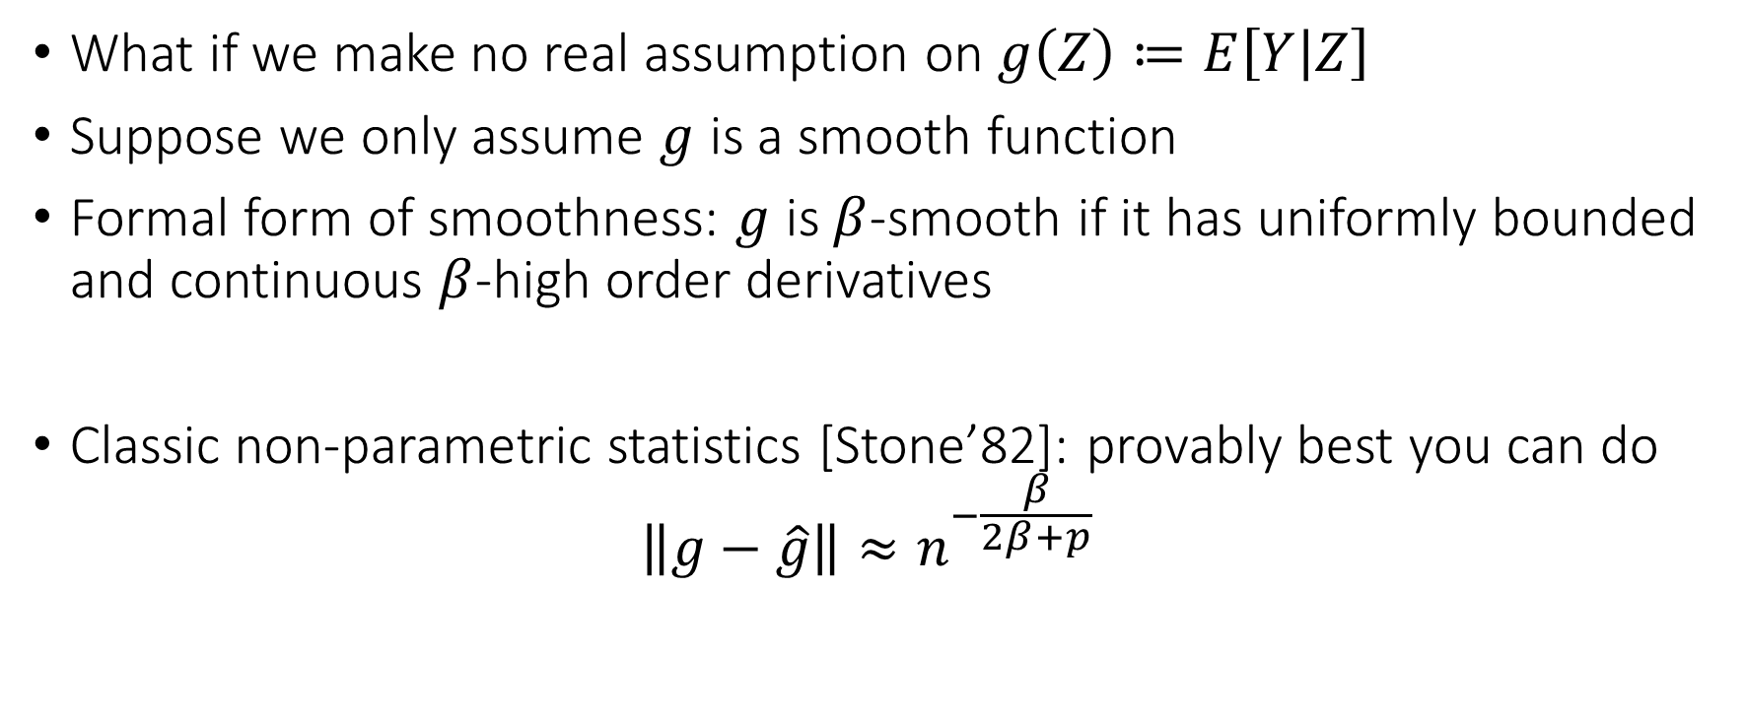
The Curse of Dimensionality
What if we make no real assumption on $g\left(Z\right)≔E\left[Y | Z\right]$
Suppose we only assume $g$ is a smooth function
Formal form of smoothness: $g$ is $β$-smooth if it has uniformly bounded and continuous $β$-high order derivatives
Classic non-parametric statistics [Stone’82]: provably best you can do
$$\left\|g−\hat{g}\right\|≈n^{−\frac{β}{2β+p}}$$

Slide 8
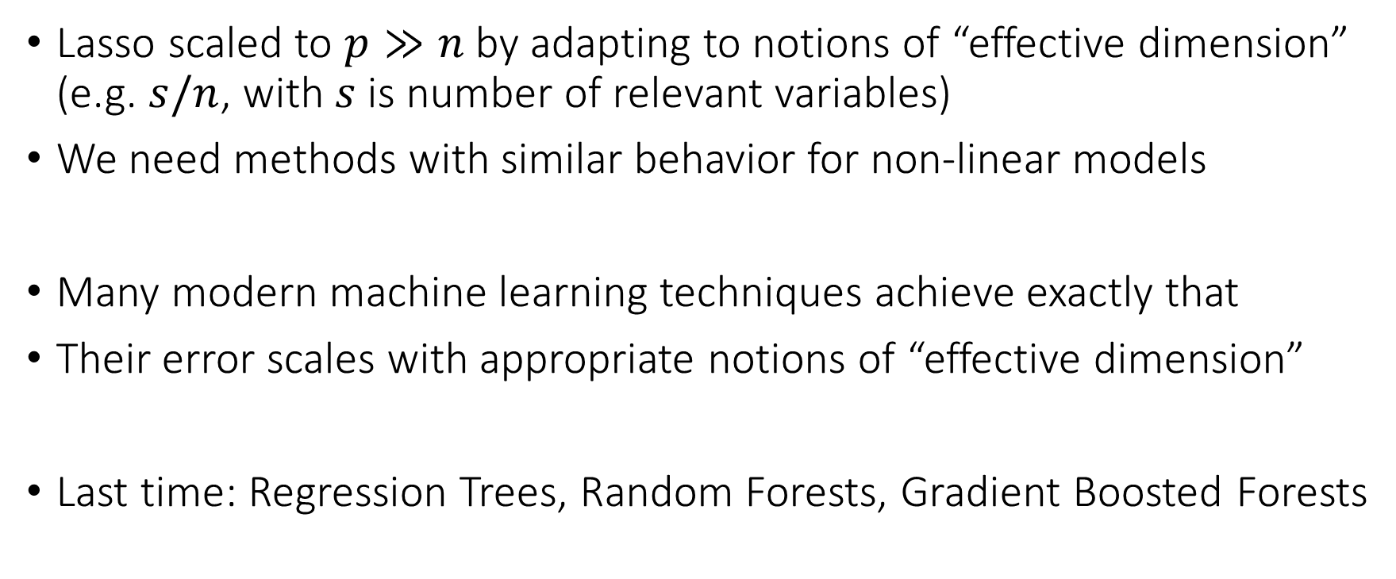
Bypassing the Curse of Dimensionality
Lasso scaled to $p≫n$ by adapting to notions of “effective dimension” (e.g. $s/n$, with $s$ is number of relevant variables)
We need methods with similar behavior for non-linear models
Many modern machine learning techniques achieve exactly that
Their error scales with appropriate notions of “effective dimension”
Last time: Regression Trees, Random Forests, Gradient Boosted Forests

Slide 9
Goals for Today
Neural Networks
Some theoretical guarantees and justification (similar to lasso)
How to combine models (stacking)
How to automate the process (automl)
NNets for feature engineering

Slide 10
Modern Non-Linear Predictive Models: Neural Networks

Slide 11
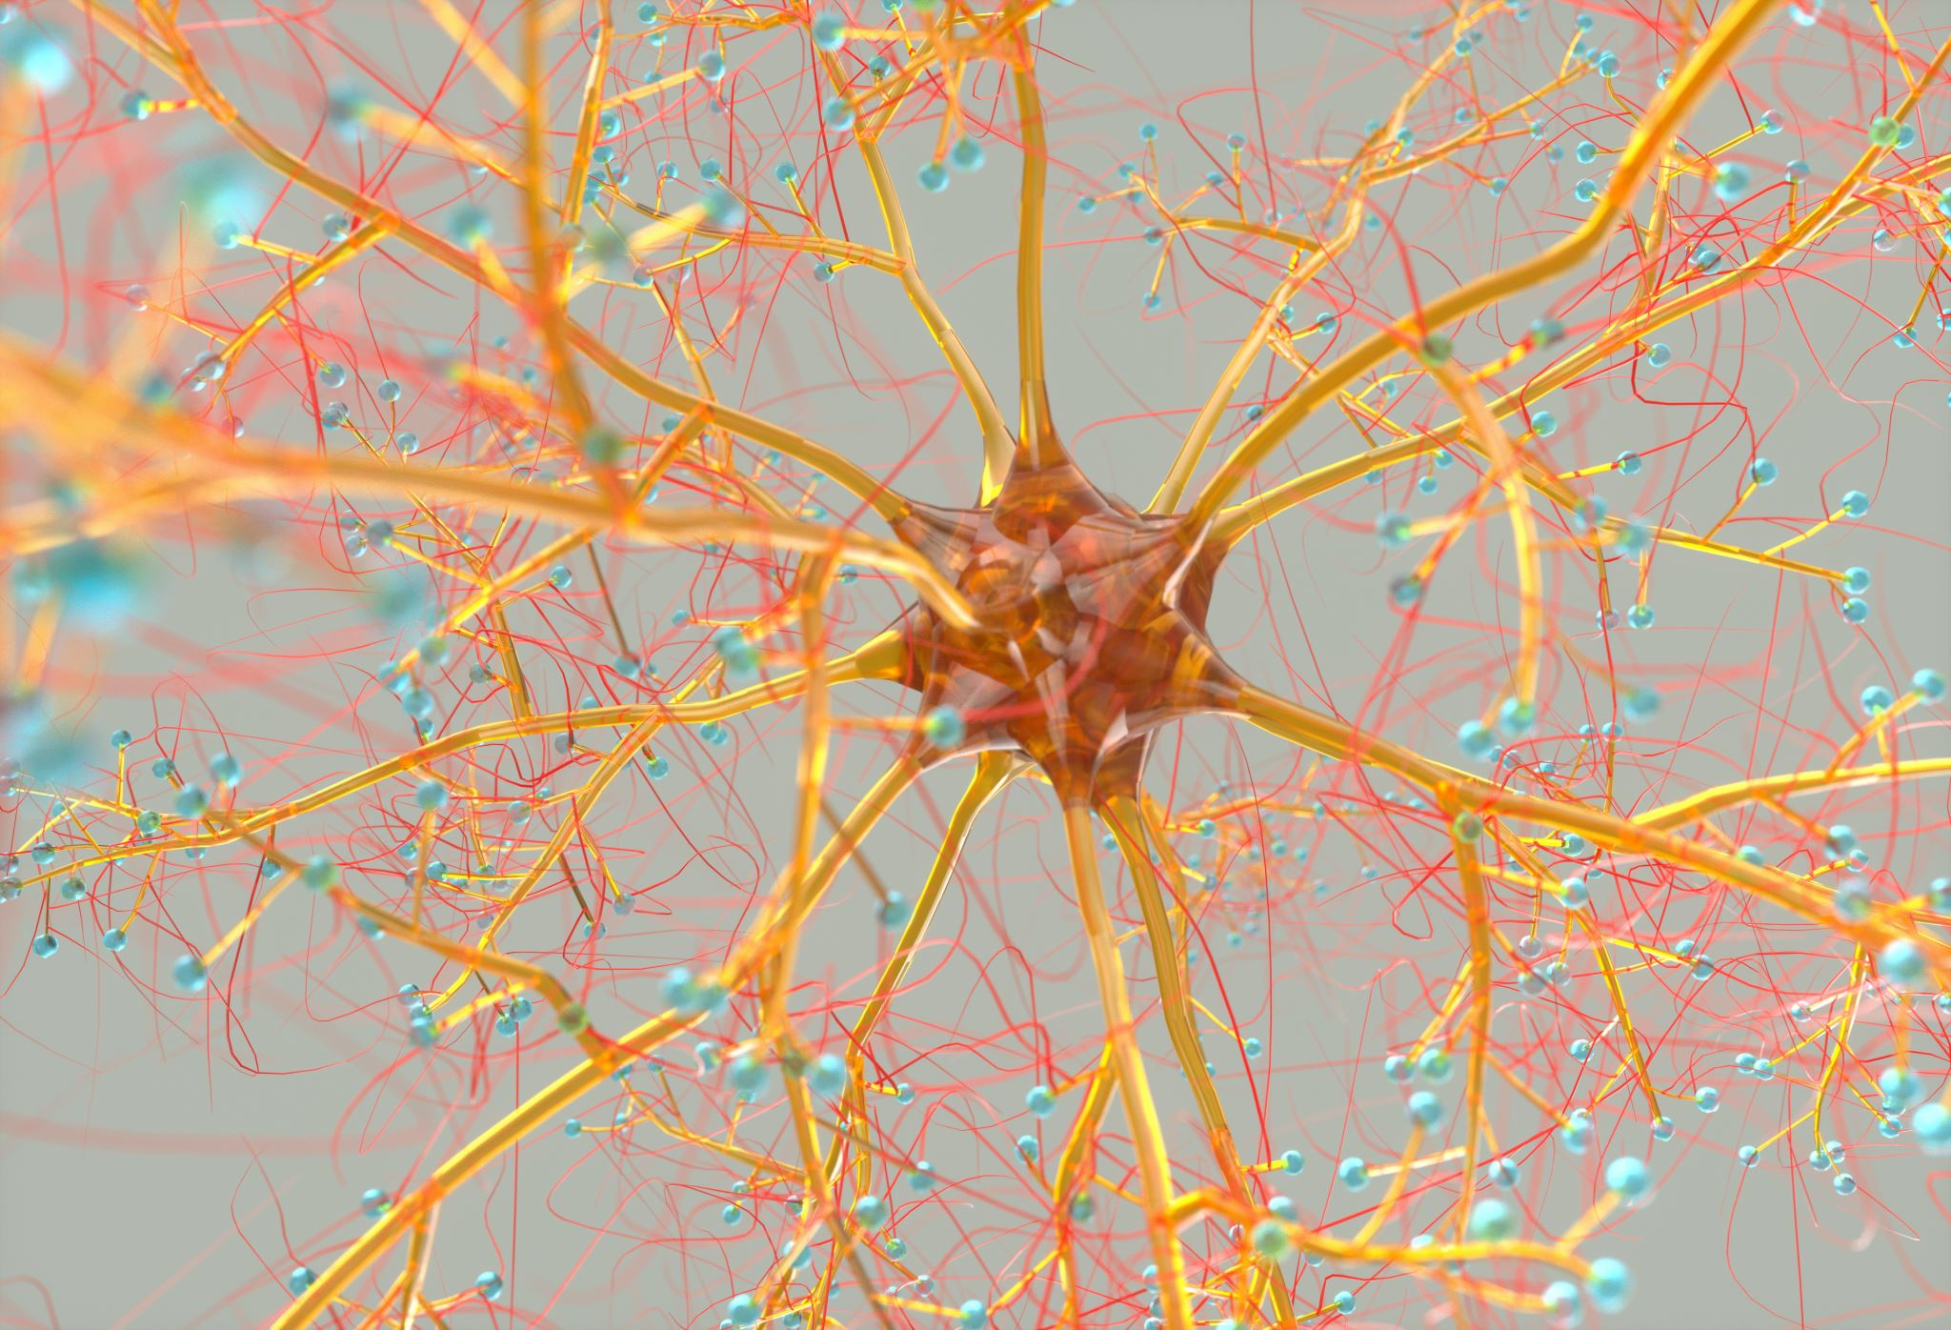
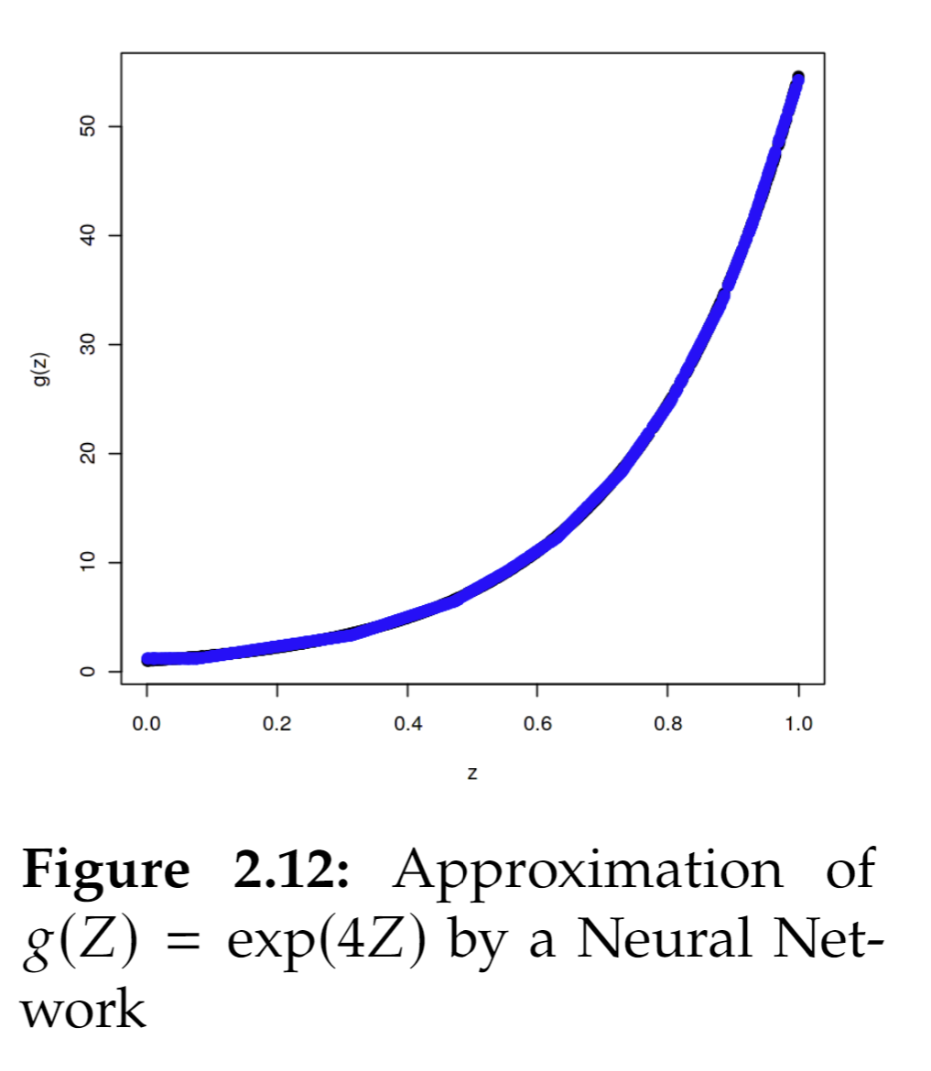
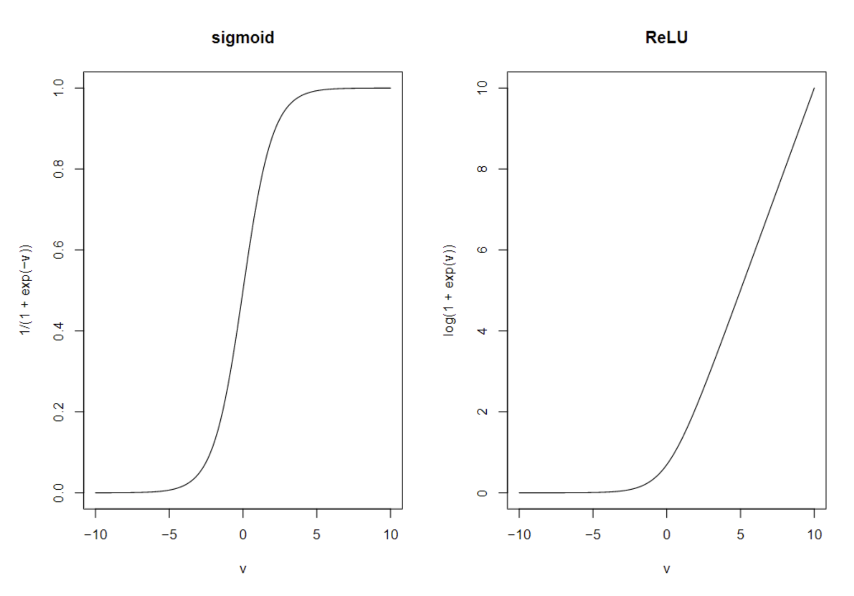
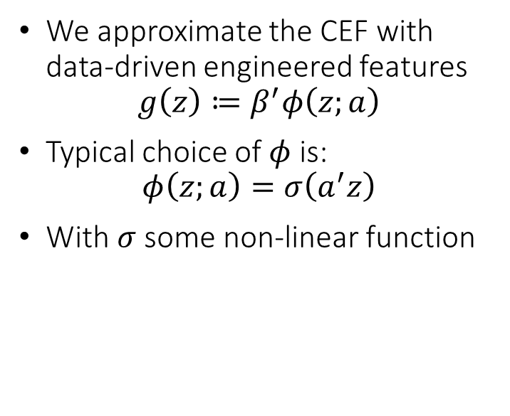
(Shallow) Neural Networks
We approximate the CEF with data-driven engineered features
$$g\left(z\right)≔β^{′}φ\left(z;a\right)$$
Typical choice of $φ$ is:
$$φ\left(z;a\right)=σ\left(a^{′}z\right)$$
With $σ$ some non-linear function

Slide 12
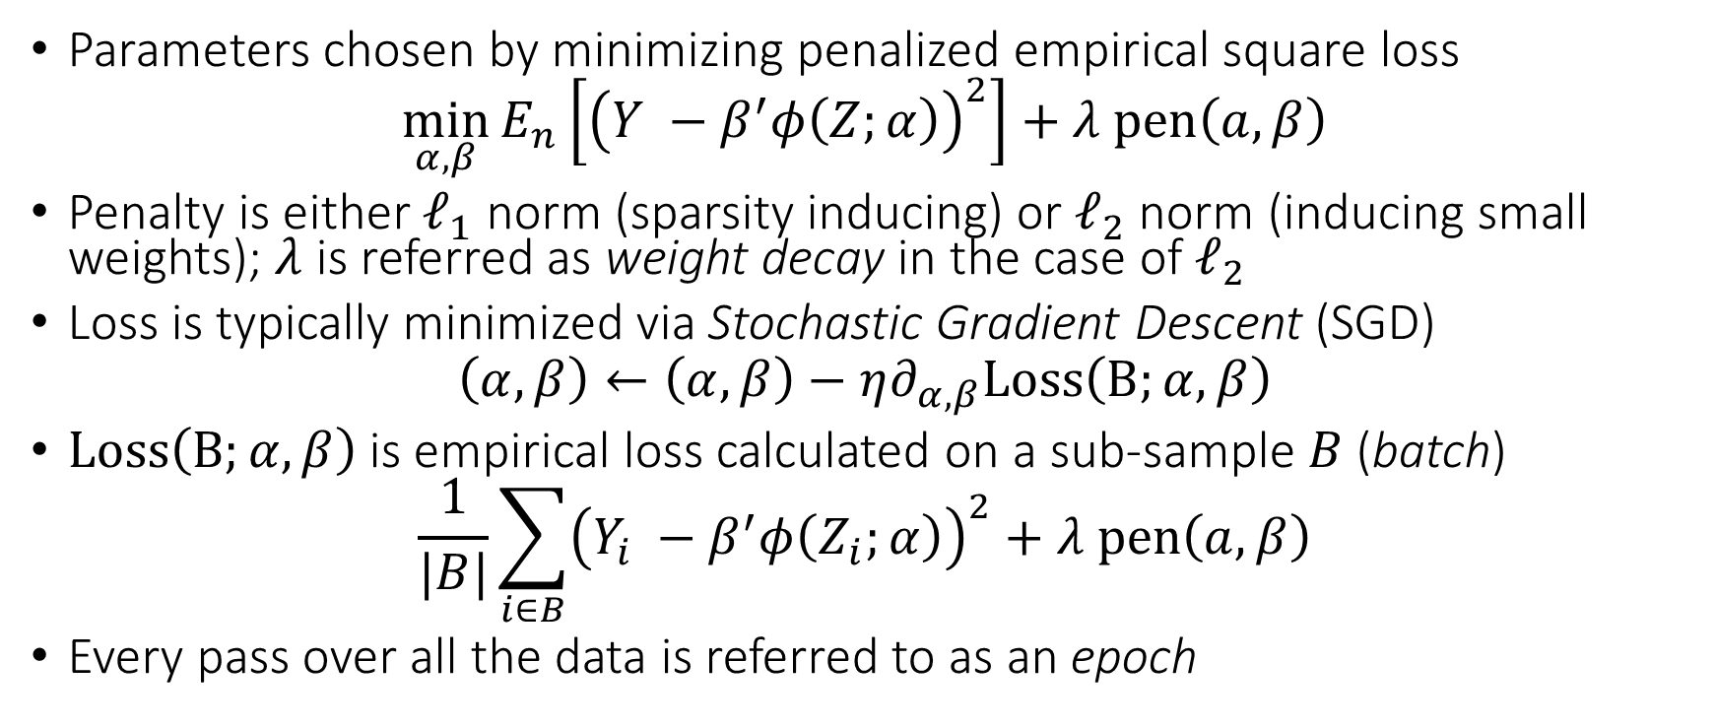
(Shallow) Neural Network Objective
Parameters chosen by minimizing penalized empirical square loss
$$\min_{α,β}{E_{n}\left[{\left(Y −β^{′}φ\left(Z;α\right)\right)}^{2}\right]+λ pen\left(a,β\right)}$$
Penalty is either $ℓ_{1}$ norm (sparsity inducing) or $ℓ_{2}$ norm (inducing small weights); $λ$ is referred as weight decay in the case of $ℓ_{2}$
Loss is typically minimized via Stochastic Gradient Descent (SGD)
$$\left(α,β\right)←\left(α,β\right)−η∂_{α,β}Loss\left(B;α,β\right)$$
$Loss\left(B;α,β\right)$ is empirical loss calculated on a sub-sample $B$ (batch)
$$\frac{1}{|B|}\sum_{i∈B}{{\left(Y_{i} −β^{′}φ\left(Z_{i};α\right)\right)}^{2}}+λ pen\left(a,β\right)$$
Every pass over all the data is referred to as an epoch

Slide 13
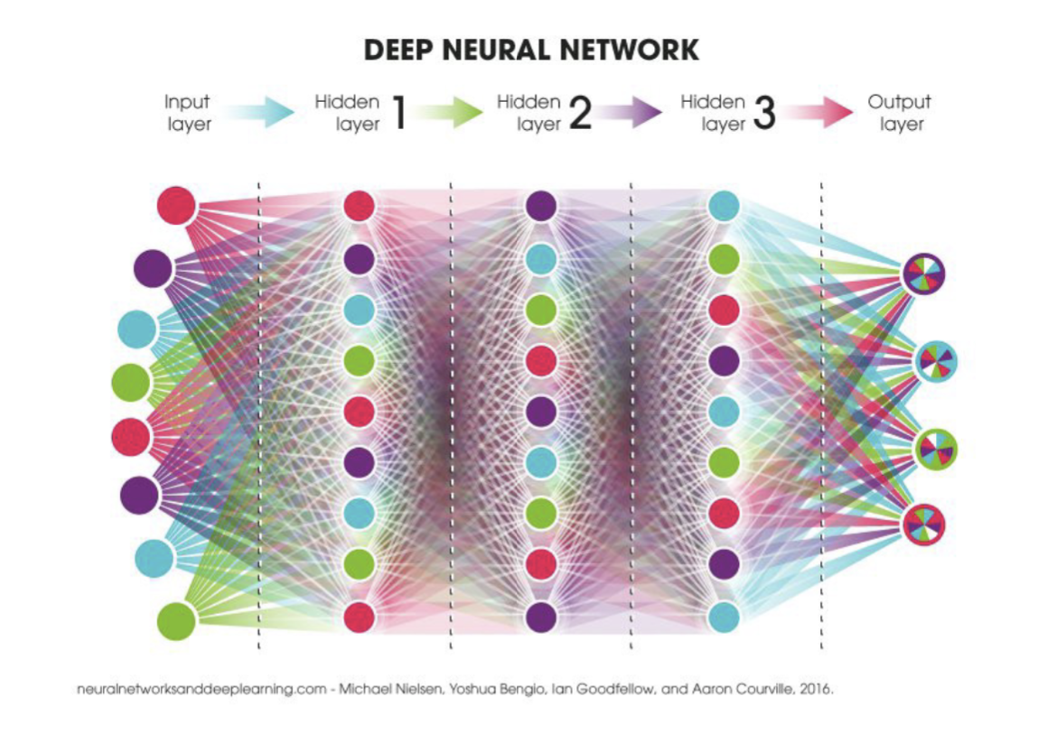

Slide 14
Forms of Regularization
Stochasticity and iterative nature of SGD is by itself a regularization method (implicit regularization)
Penalties are explicit form of regularization
Drop-out. At each training step, shutdown some of the neurons. Implicitly regularizes by having multiple neurons learn important concepts, acting as substitutes
Early stopping. Measure out of sample performance after a few iterations of SGD and stop if it stops improving

Slide 15
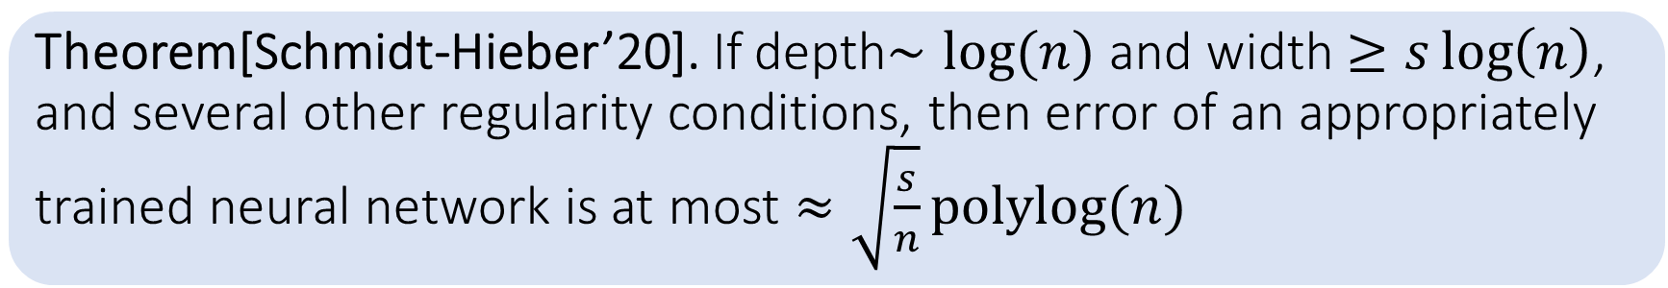
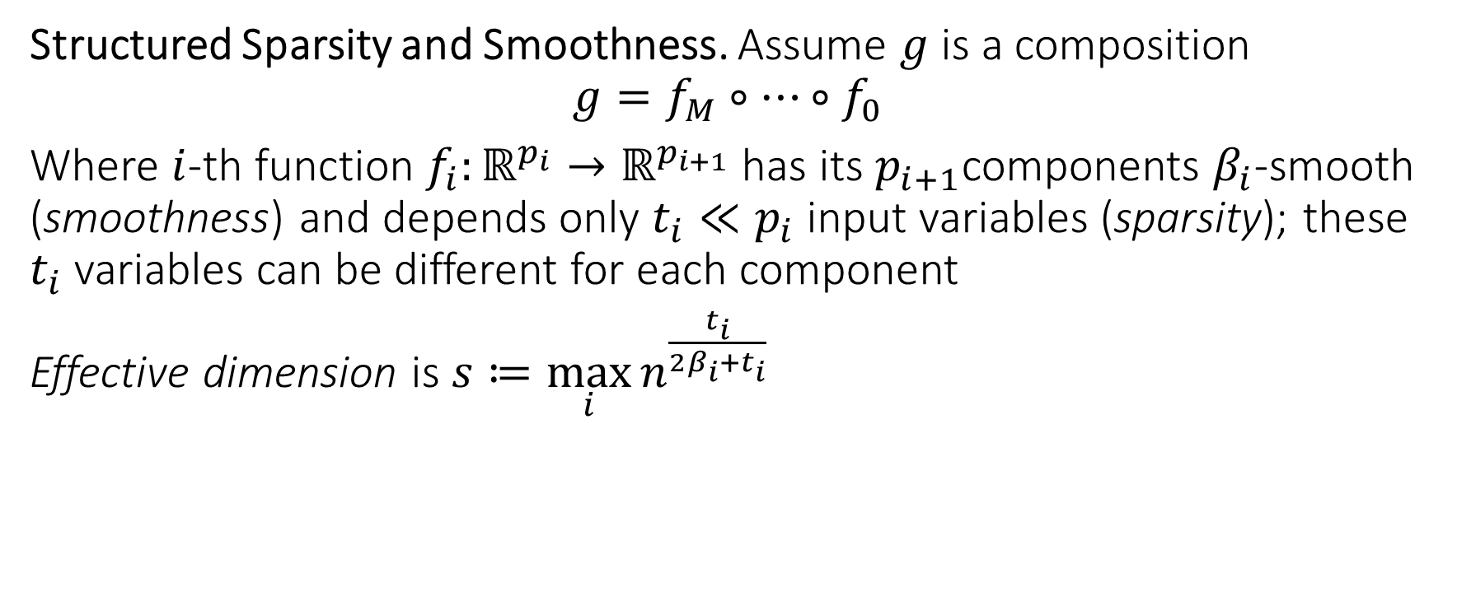
Some Theory
Structured Sparsity and Smoothness. Assume $g$ is a composition
$$g=f_{M}∘…∘f_{0}$$
Where $i$-th function $f_{i}:ℝ^{p_{i}}→ℝ^{p_{i+1}}$ has its $p_{i+1}$components $β_{i}$-smooth (smoothness) and depends only $t_{i}≪p_{i}$ input variables (sparsity); these $t_{i}$ variables can be different for each component
Effective dimension is $s≔\max_{i}{n^{\frac{t_{i}}{2β_{i}+t_{i}}}}$
Theorem[Schmidt-Hieber’20]. If depth$∼log⁡(n)$ and width $≥s\log\left(n\right)$, and several other regularity conditions, then error of an appropriately trained neural network is at most $≈\sqrt{\frac{s}{n}}polylog(n)$

Slide 16
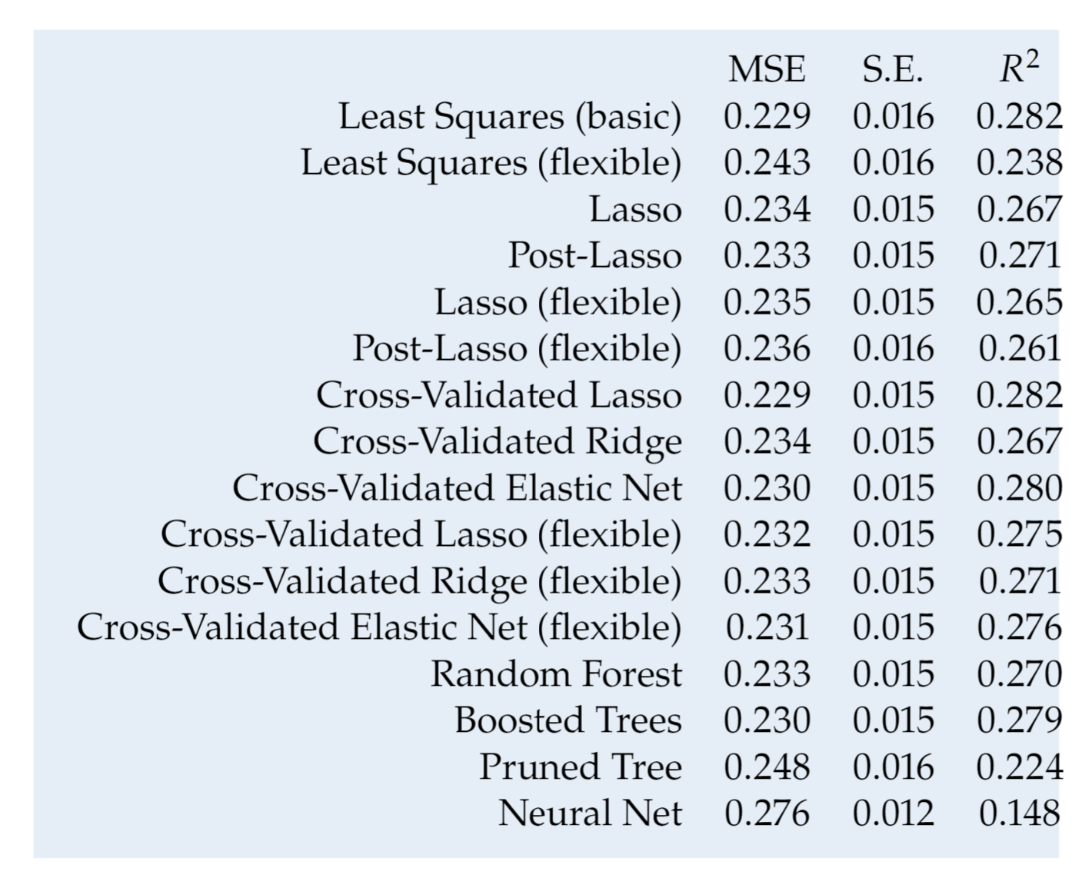
A Reminder: Fancy isn’t always better
Predictive performance for predicting wages

Slide 17
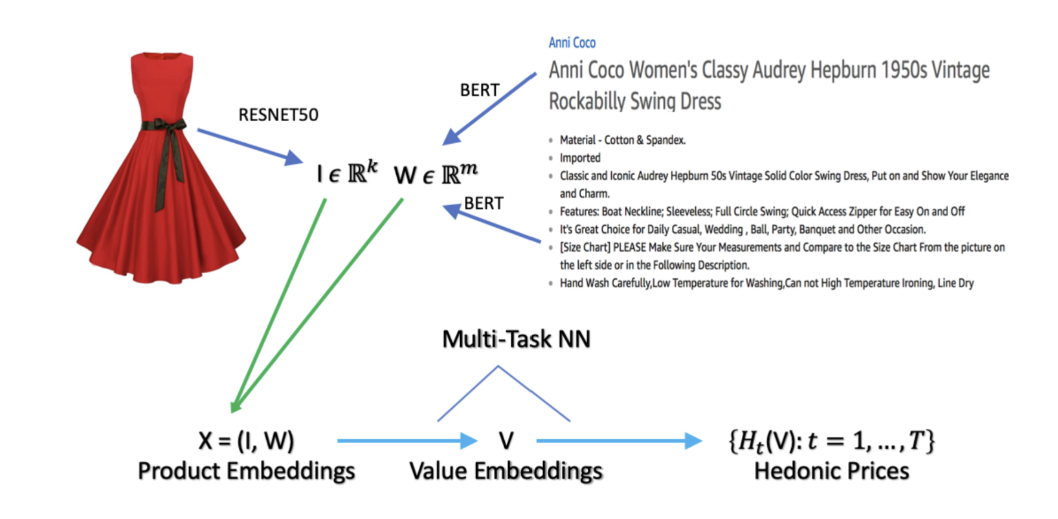
But many times it is crucial
Predicting prices from product characteristics at Amazon
Bajari et al. 2021, Hedonic prices and quality adjusted price indices powered by AI.

Slide 18
Which method should I use?
Stacking and Ensembling

Slide 19
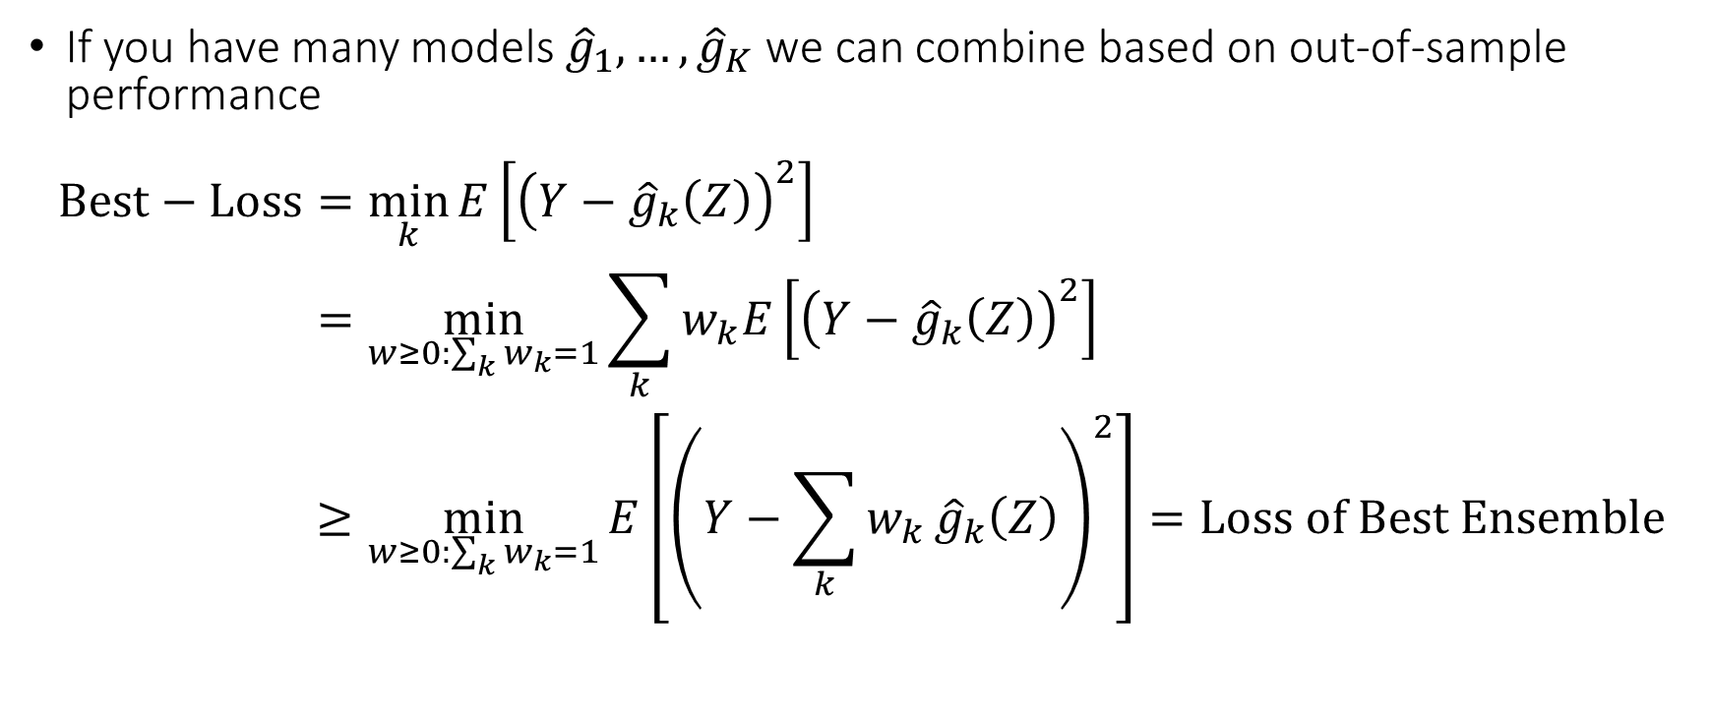
Use all and combine: Stacking
If you have many models ${\hat{g}}_{1},…,{\hat{g}}_{K}$ we can combine based on out-of-sample performance
$$\begin{aligned}Best−Loss=&\min_{k}{E\left[{\left(Y−{\hat{g}}_{k}\left(Z\right)\right)}^{2}\right]} \\ =&\min_{w≥0:\sum_{k}{w_{k}}=1}{\sum_{k}{w_{k}E\left[{\left(Y−{\hat{g}}_{k}\left(Z\right)\right)}^{2}\right]}} \\ ≥&\min_{w≥0:\sum_{k}{w_{k}}=1}{E\left[{\left(Y−\sum_{k}{w_{k}}{\hat{g}}_{k}\left(Z\right)\right)}^{2}\right]}=Loss of Best Ensemble\end{aligned}$$

Slide 20
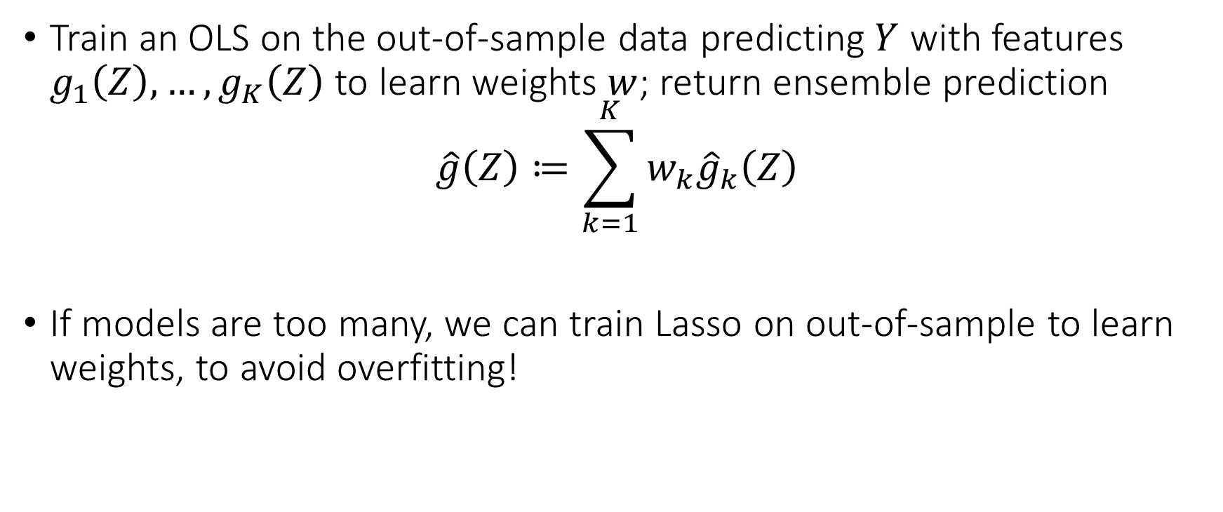
Stacking
Train an OLS on the out-of-sample data predicting $Y$ with features $g_{1}\left(Z\right),…,g_{K}\left(Z\right)$ to learn weights $w$; return ensemble prediction
$$\hat{g}\left(Z\right)≔\sum_{k=1}^{K}{w_{k}{\hat{g}}_{k}\left(Z\right)}$$
If models are too many, we can train Lasso on out-of-sample to learn weights, to avoid overfitting!

Slide 21
How do I choose all these hyperparameters?

Slide 22
Use Auto-ML frameworks!
Automatic and clever search over the hyperparameter space
Very few lines of code
Typically much better performance than handpicking yourself
Unless a lot of domain knowledge of what types of functions are better approximators
Many user-friendly tools: H2O-AutoML, Auto-Gluon, Azure-AutoML, FLAML, Auto-Sklearn, HyperOpt-Sklearn

Slide 23
Feature Engineering with Pre-Trained Neural Networks
PCA, Large Language Models, Large Vision Models

Slide 24
Auto-Encoders

Slide 25
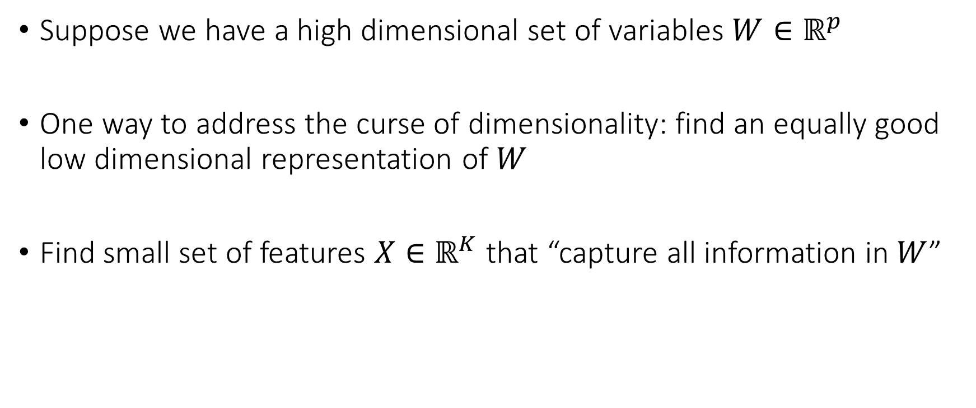
Reducing Dimensionality via Latent Embeddings
Suppose we have a high dimensional set of variables $W∈ℝ^{p}$
One way to address the curse of dimensionality: find an equally good low dimensional representation of $W$
Find small set of features $X∈ℝ^{K}$ that “capture all information in $W$”

Slide 26
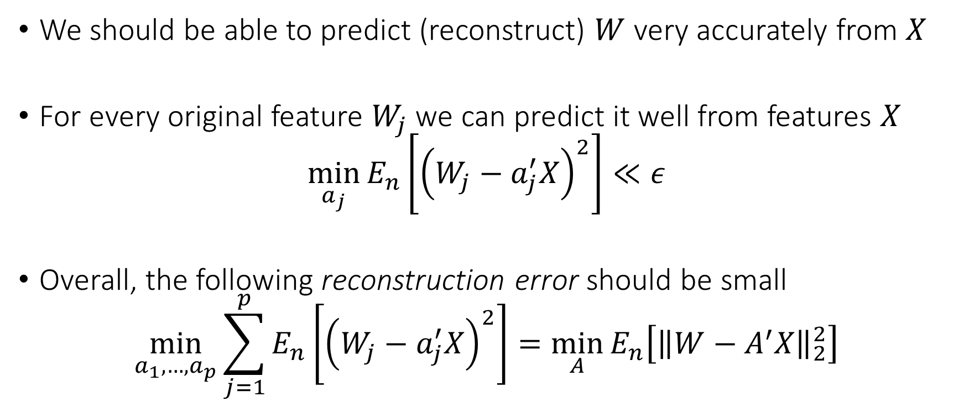
Reconstruction Error Objective
We should be able to predict (reconstruct) $W$ very accurately from $X$
For every original feature $W_{j}$ we can predict it well from features $X$
$$\min_{a_{j}}{E_{n}\left[{\left(W_{j}−a_{j}^{′}X\right)}^{2}\right]}≪ε$$
Overall, the following reconstruction error should be small
$$\min_{a_{1},…,a_{p}}{\sum_{j=1}^{p}{E_{n}\left[{\left(W_{j}−a_{j}^{′}X\right)}^{2}\right]}=\min_{A}{E_{n}\left[{\left\|W−A^{′}X\right\|}_{2}^{2}\right]}}$$

Slide 27
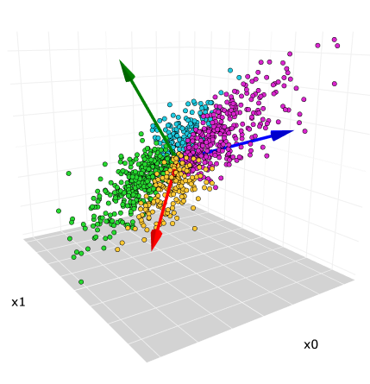
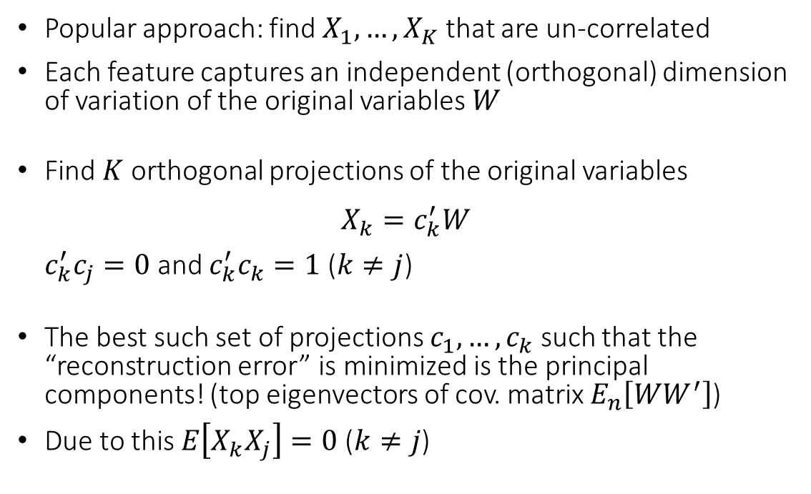
Principal Components
Popular approach: find $X_{1},…,X_{K}$ that are un-correlated
Each feature captures an independent (orthogonal) dimension of variation of the original variables $W$
Find $K$ orthogonal projections of the original variables
$$X_{k}=c_{k}^{′}W$$
$c_{k}^{′}c_{j}=0$ and $c_{k}^{′}c_{k}=1$ ($k≠j$)
The best such set of projections $c_{1},…,c_{k}$ such that the “reconstruction error” is minimized is the principal components! (top eigenvectors of cov. matrix $E_{n}\left[WW^{′}\right]$)
Due to this $E\left[X_{k}X_{j}\right]=0$ ($k≠j$)
Image Source: https://towardsdatascience.com/principal-component-analysis-pca-explained-visually-with-zero-math-1cbf392b9e7d

Slide 28
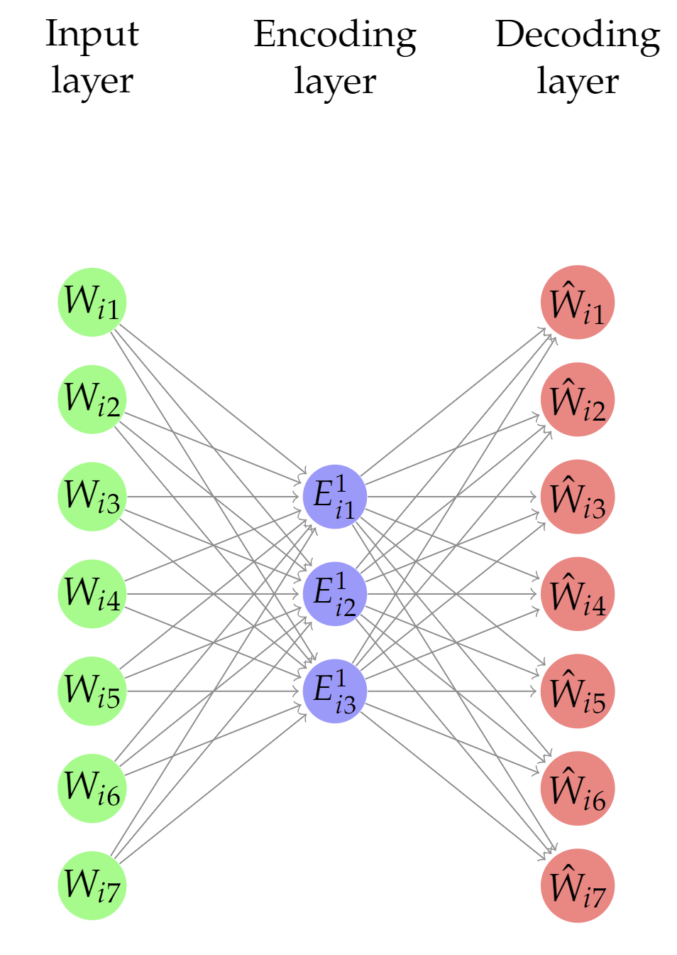
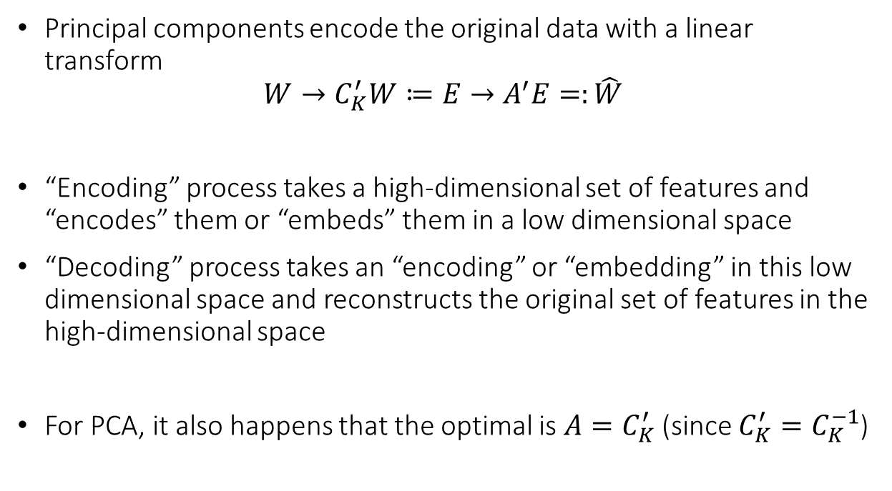
Principal Components as Encoders-Decoders
Principal components encode the original data with a linear transform
$$W→C_{K}^{′}W≔E→A^{′}E=:\hat{W}$$
“Encoding” process takes a high-dimensional set of features and “encodes” them or “embeds” them in a low dimensional space
“Decoding” process takes an “encoding” or “embedding” in this low dimensional space and reconstructs the original set of features in the high-dimensional space
For PCA, it also happens that the optimal is $A=C_{K}^{′}$ (since $C_{K}^{′}=C_{K}^{−1}$)

Slide 29
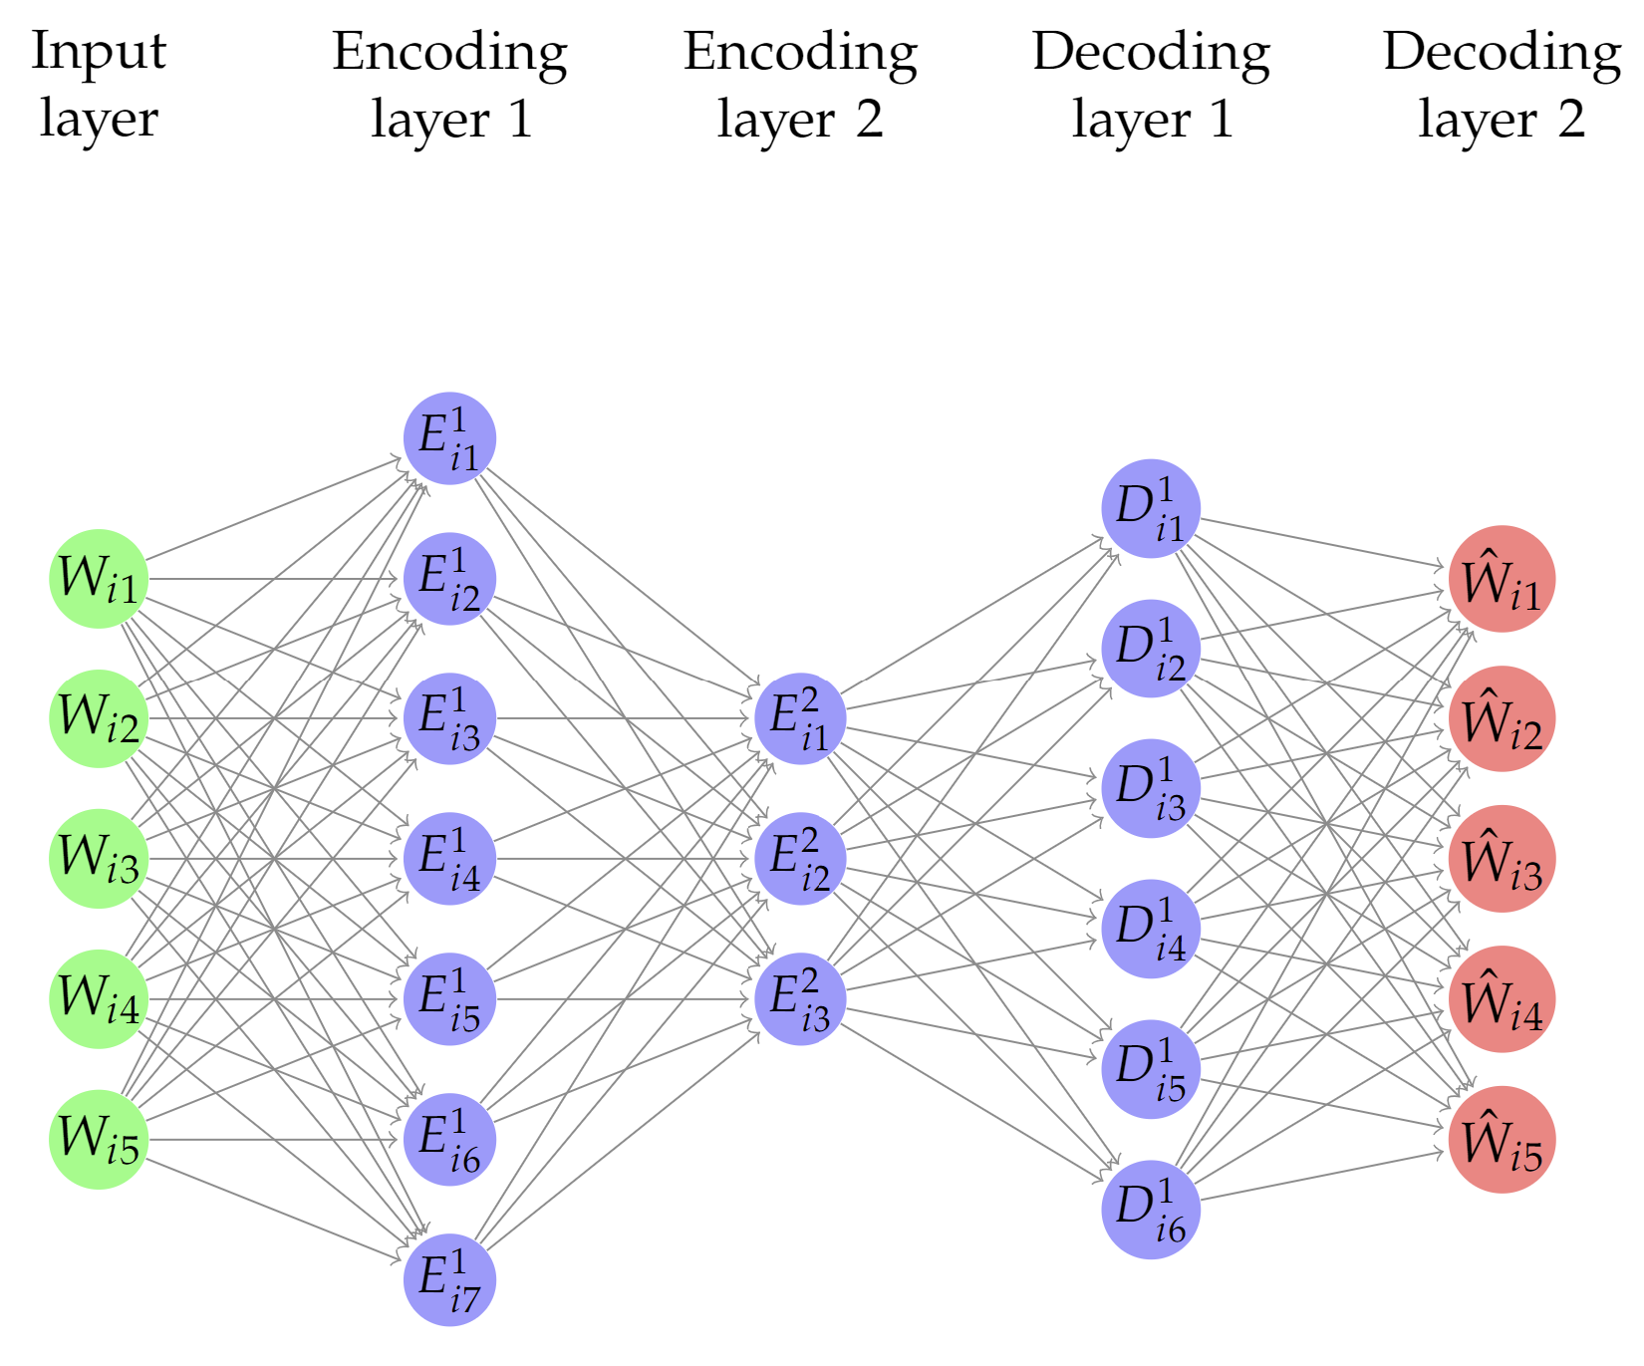
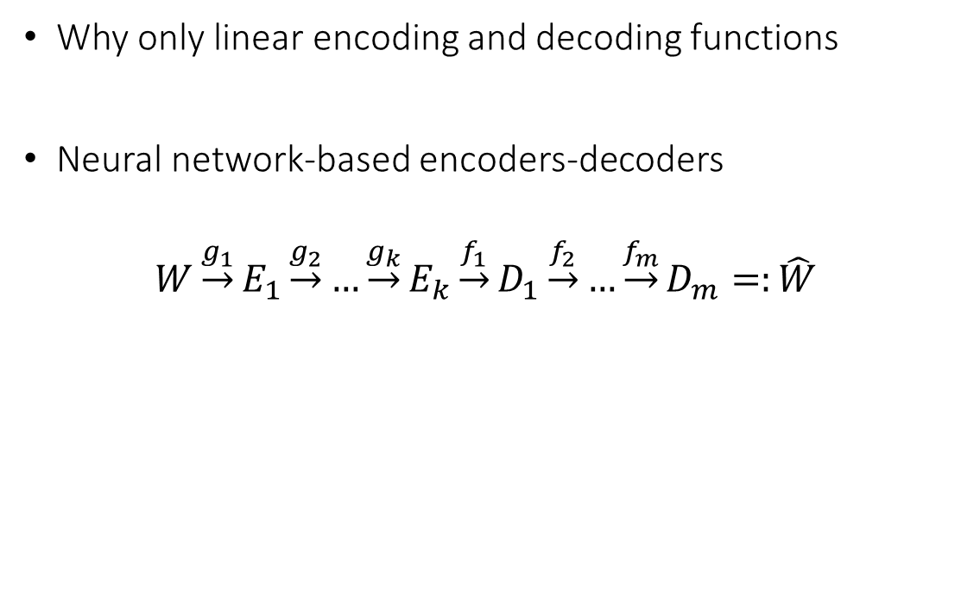
Deep Encoders-Decoders (Auto-Encoders)
Why only linear encoding and decoding functions
Neural network-based encoders-decoders
$$W\underset{→}{g_{1}}E_{1}\underset{→}{g_{2}}…\underset{→}{g_{k}}E_{k}\underset{→}{f_{1}}D_{1}\underset{→}{f_{2}}…\underset{→}{f_{m}}D_{m}=:\hat{W}$$

Slide 30
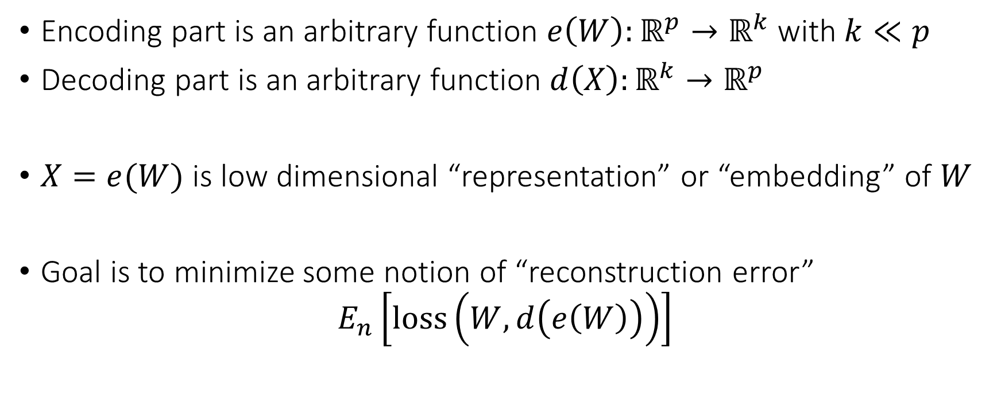
Deep Auto-Encoders
Encoding part is an arbitrary function $e\left(W\right):ℝ^{p}→ℝ^{k}$ with $k≪p$
Decoding part is an arbitrary function $d\left(X\right):ℝ^{k}→ℝ^{p}$
$X=e(W)$ is low dimensional “representation” or “embedding” of $W$
Goal is to minimize some notion of “reconstruction error”
$$E_{n}\left[loss\left(W, d\left(e\left(W\right)\right)\right)\right]$$

Slide 31
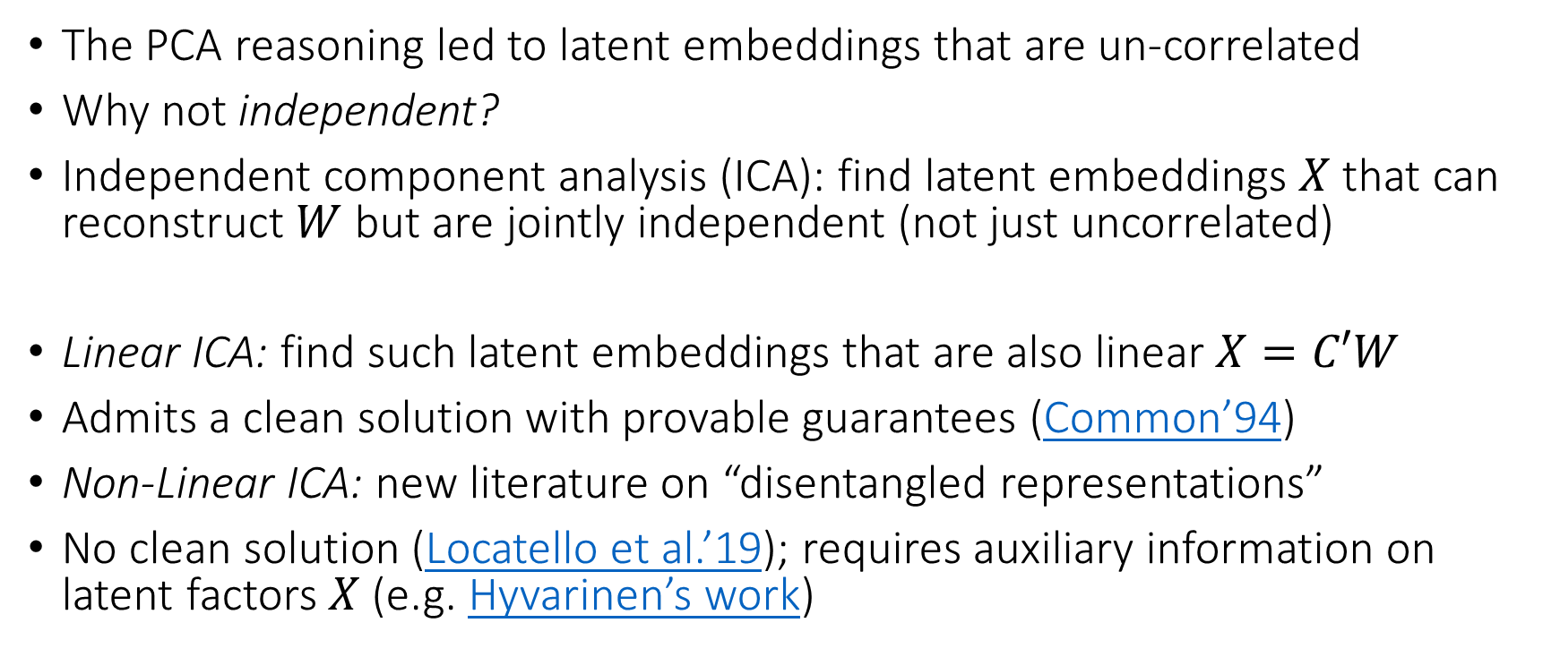
From PCA to ICA
The PCA reasoning led to latent embeddings that are un-correlated
Why not independent?
Independent component analysis (ICA): find latent embeddings $X$ that can reconstruct $W$ but are jointly independent (not just uncorrelated)
Linear ICA: find such latent embeddings that are also linear $X=C′W$
Admits a clean solution with provable guarantees (Common’94)
Non-Linear ICA: new literature on “disentangled representations”
No clean solution (Locatello et al.’19); requires auxiliary information on latent factors $X$ (e.g. Hyvarinen’s work)

Slide 32
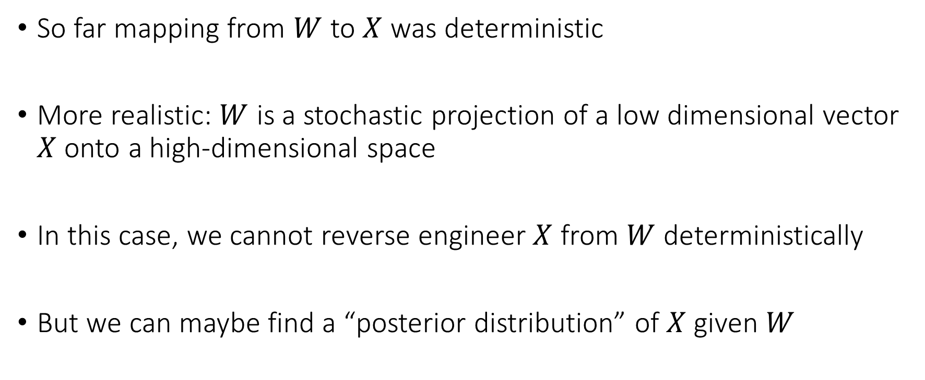
Variational Auto-Encoders
So far mapping from $W$ to $X$ was deterministic
More realistic: $W$ is a stochastic projection of a low dimensional vector $X$ onto a high-dimensional space
In this case, we cannot reverse engineer $X$ from $W$ deterministically
But we can maybe find a “posterior distribution” of $X$ given $W$

Slide 33
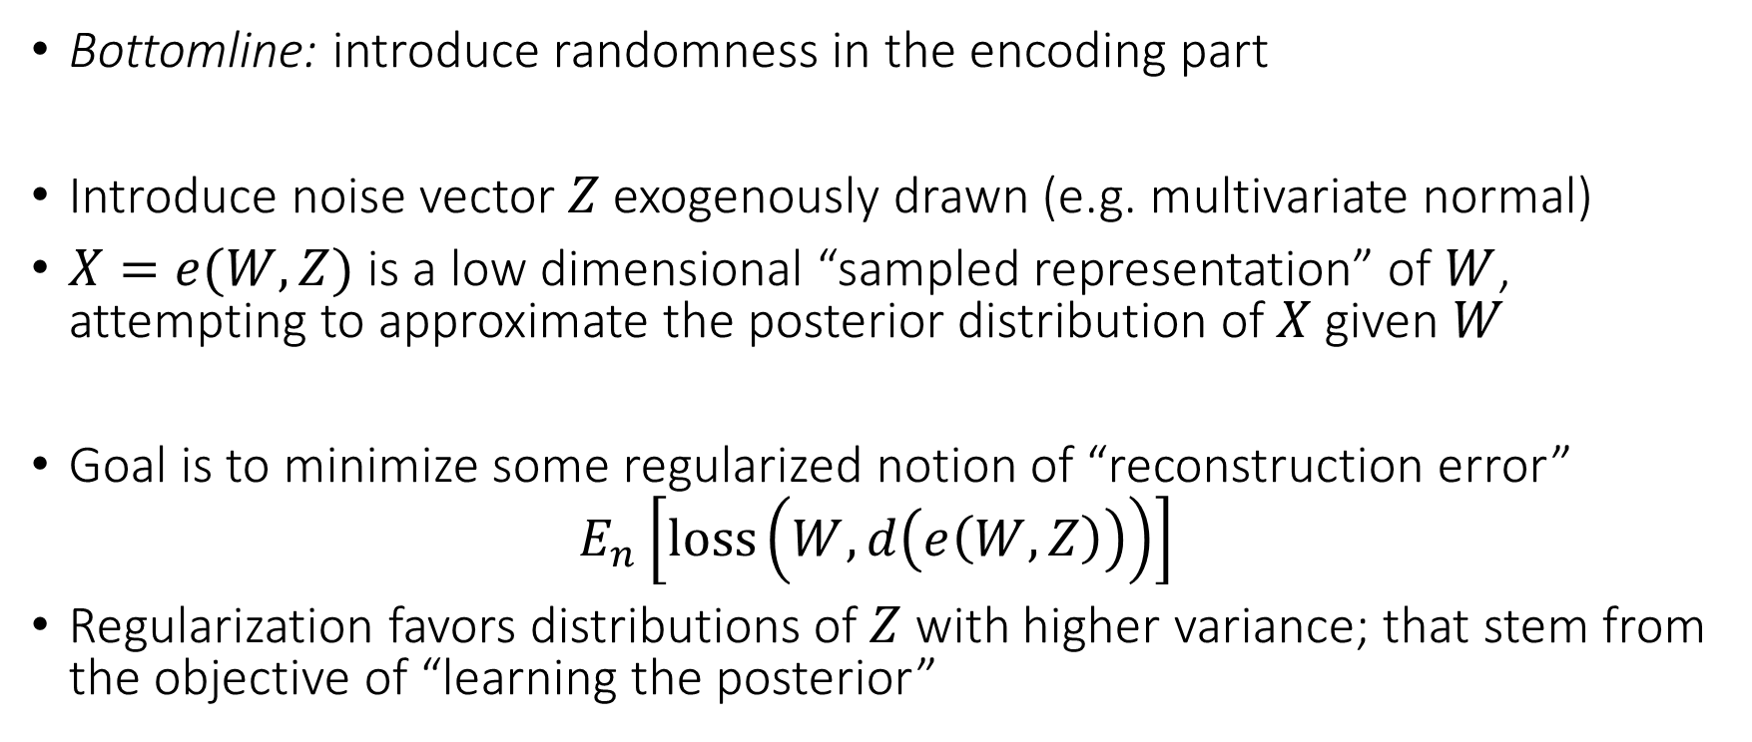
Variational Auto-Encoders
Bottomline: introduce randomness in the encoding part
Introduce noise vector $Z$ exogenously drawn (e.g. multivariate normal)
$X=e(W, Z)$ is a low dimensional “sampled representation” of $W$, attempting to approximate the posterior distribution of $X$ given $W$
Goal is to minimize some regularized notion of “reconstruction error”
$$E_{n}\left[loss\left(W, d\left(e\left(W,Z\right)\right)\right)\right]$$
Regularization favors distributions of $Z$ with higher variance; that stem from the objective of “learning the posterior”

Slide 34
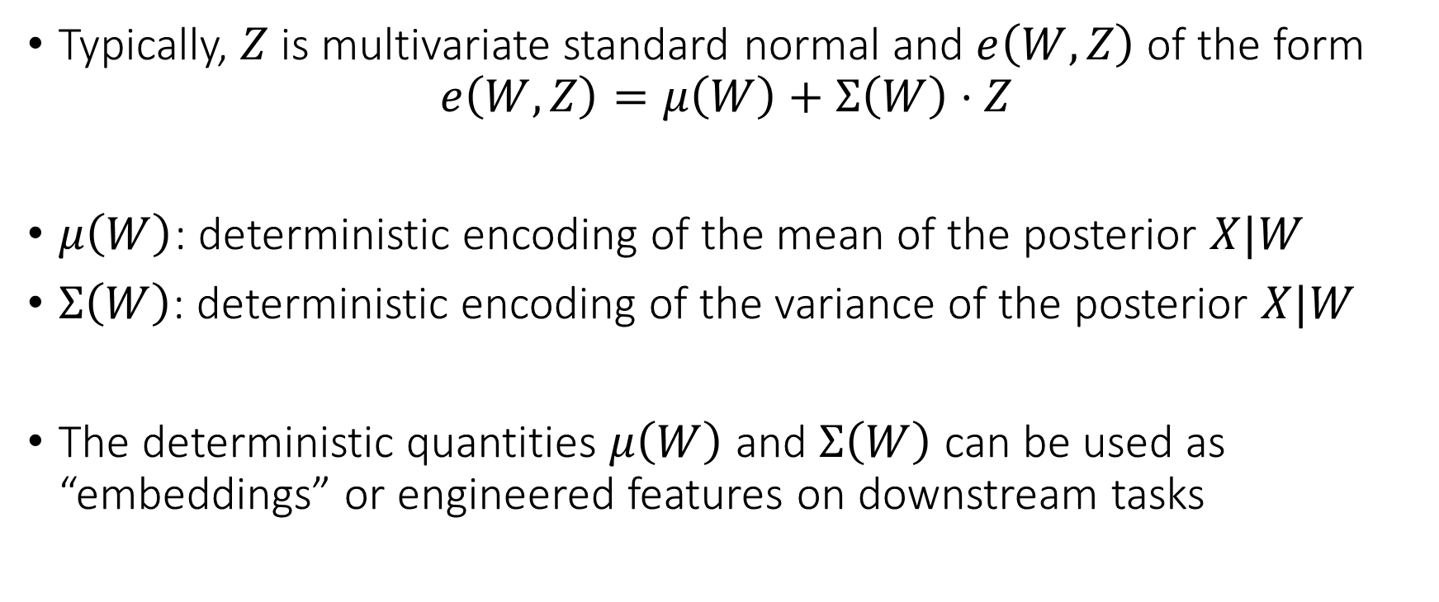
Variational Auto-Encoders
Typically, $Z$ is multivariate standard normal and $e\left(W, Z\right)$ of the form
$$e\left(W,Z\right)=μ\left(W\right)+Σ\left(W\right)⋅Z$$
$μ\left(W\right)$: deterministic encoding of the mean of the posterior $X|W$
$Σ\left(W\right)$: deterministic encoding of the variance of the posterior $X|W$
The deterministic quantities $μ\left(W\right)$ and $Σ\left(W\right)$ can be used as “embeddings” or engineered features on downstream tasks

Slide 35
General Embeddings

Slide 36
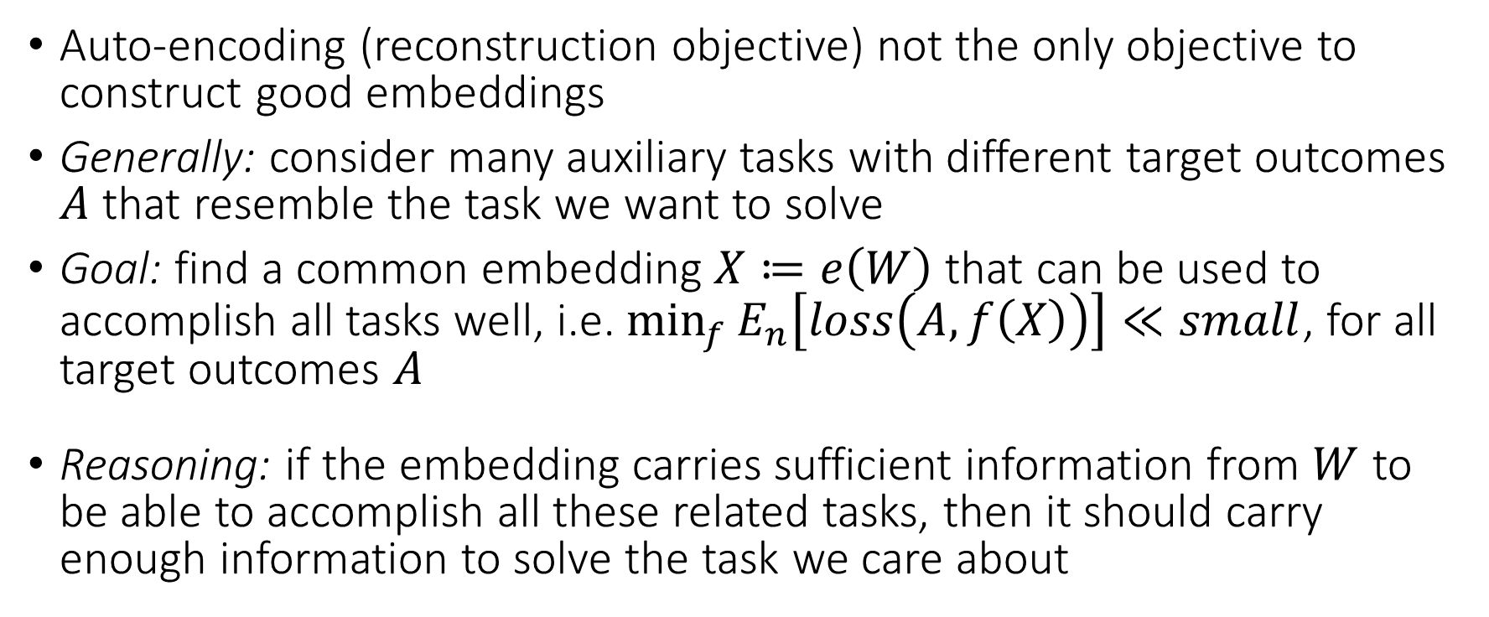
From Auto-Encoders to General Embeddings
Auto-encoding (reconstruction objective) not the only objective to construct good embeddings
Generally: consider many auxiliary tasks with different target outcomes $A$ that resemble the task we want to solve
Goal: find a common embedding $X≔e\left(W\right)$ that can be used to accomplish all tasks well, i.e. $\min_{f}{E_{n}\left[loss\left(A, f\left(X\right)\right)\right]}≪small$, for all target outcomes $A$
Reasoning: if the embedding carries sufficient information from $W$ to be able to accomplish all these related tasks, then it should carry enough information to solve the task we care about

Slide 37
From Auto-Encoders to General Embeddings
For text data, find an embeddings that perform well in many language tasks (e.g. Q&A, fill the gaps, predict next word)
For image data, find embeddings that perform well in many vision tasks (e.g. classification, object detection etc.)
Typically, we have much larger data sets for these auxiliary tasks than for the task at hand (e.g. web crawling data)
We are essentially using these auxiliary data for more informed dimensionality reduction

Slide 38
Embeddings for Text Data

Slide 39
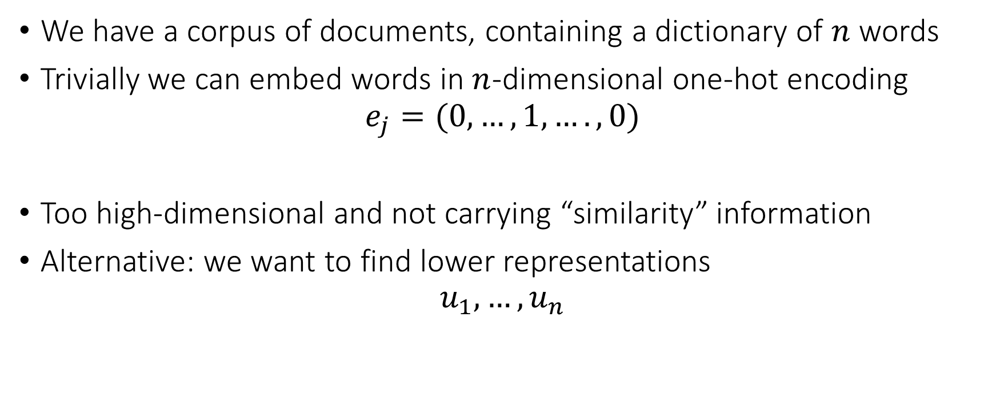
Word2vec
We have a corpus of documents, containing a dictionary of $n$ words
Trivially we can embed words in $n$-dimensional one-hot encoding
$$e_{j}=(0,…,1,….,0)$$
Too high-dimensional and not carrying “similarity” information
Alternative: we want to find lower representations
$$u_{1},…,u_{n}$$

Slide 40
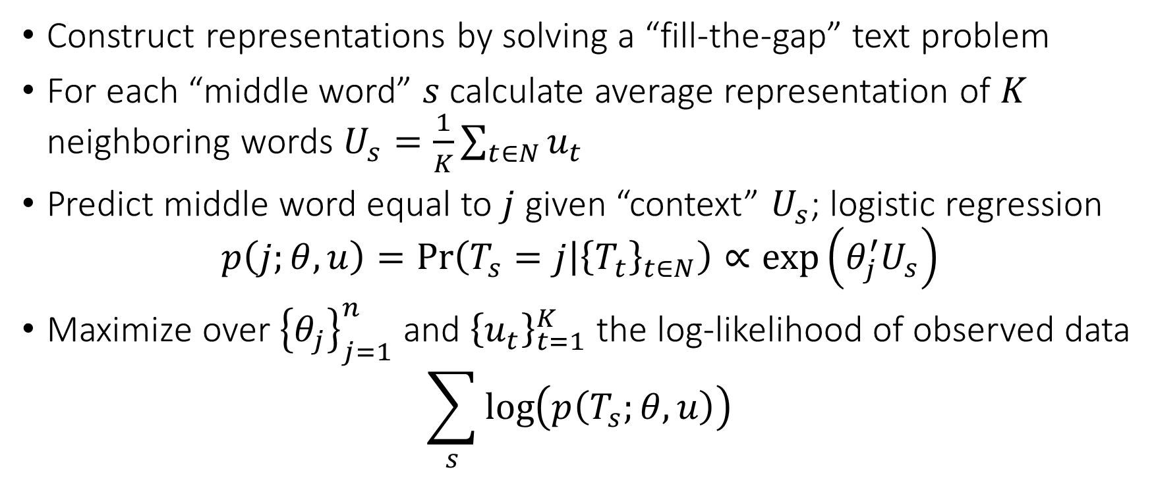
Word2vec
Construct representations by solving a “fill-the-gap” text problem
For each “middle word” $s$ calculate average representation of $K$ neighboring words $U_{s}=\frac{1}{K}\sum_{t∈N}{u_{t}}$
Predict middle word equal to $j$ given “context” $U_{s}$; logistic regression
$$p\left(j;θ,u\right)=\operatorname{Pr}\left(T_{s}=j | {\left\{T_{t}\right\}}_{t∈N}\right)∝\exp\left(θ_{j}^{′}U_{s}\right)$$
Maximize over ${\left\{θ_{j}\right\}}_{j=1}^{n}$ and ${\left\{u_{t}\right\}}_{t=1}^{K}$ the log-likelihood of observed data
$$\sum_{s}{\log\left(p\left(T_{s};θ,u\right)\right)}$$

Slide 41
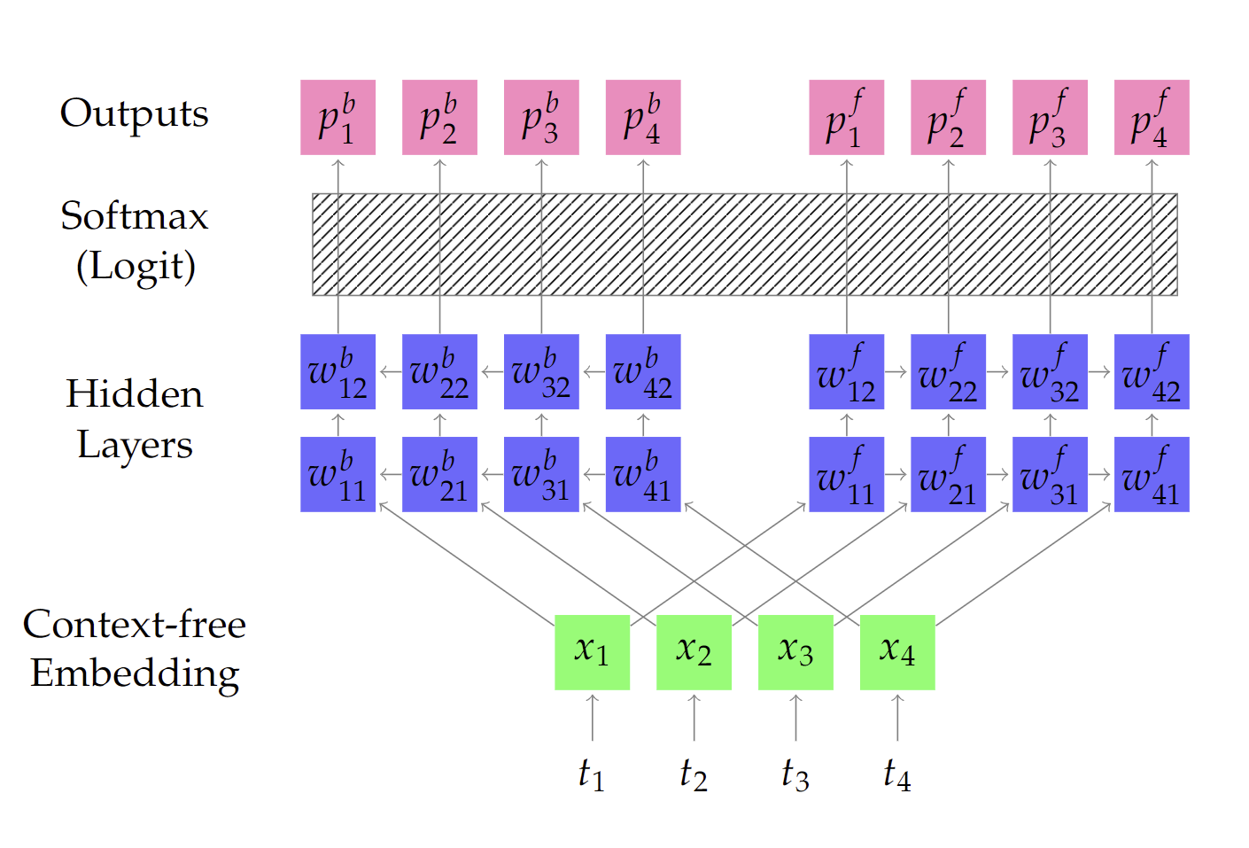
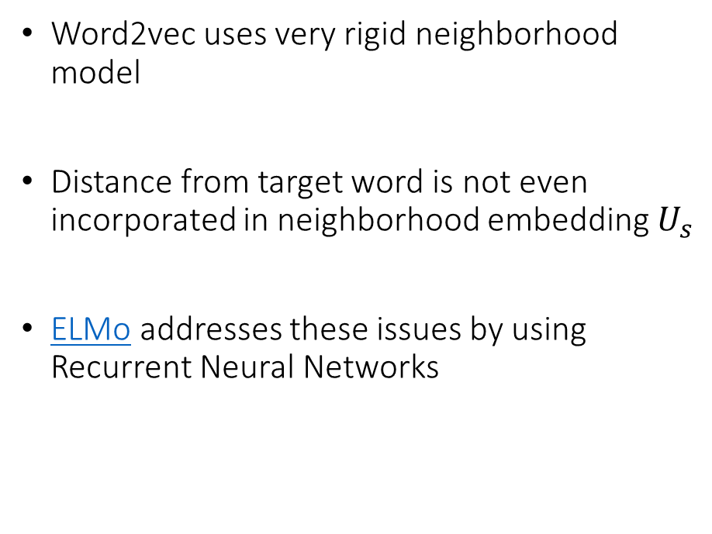
Second Generation: ELMo
Word2vec uses very rigid neighborhood model
Distance from target word is not even incorporated in neighborhood embedding $U_{s}$
ELMo addresses these issues by using Recurrent Neural Networks

Slide 42
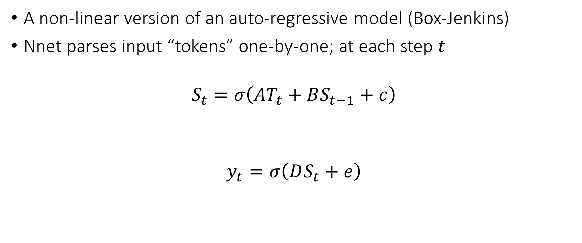
Recurrent Neural Network
A non-linear version of an auto-regressive model (Box-Jenkins)
Nnet parses input “tokens” one-by-one; at each step $t$
$$S_{t}=σ\left(AT_{t}+BS_{t−1}+c\right)$$
$$y_{t}=σ\left(DS_{t}+e\right)$$
non linearity
`
input
token
previous state
state
`
predicted outcome
state

Slide 43
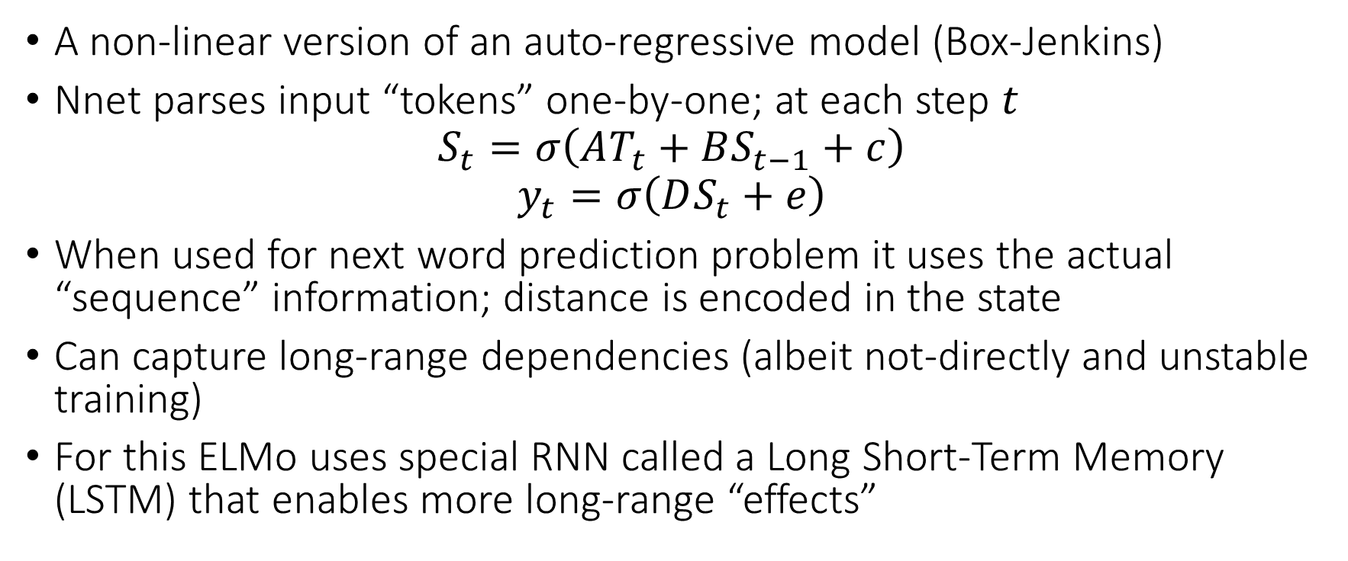
Recurrent Neural Network
A non-linear version of an auto-regressive model (Box-Jenkins)
Nnet parses input “tokens” one-by-one; at each step $t$
$$S_{t}=σ\left(AT_{t}+BS_{t−1}+c\right)$$
$$y_{t}=σ\left(DS_{t}+e\right)$$
When used for next word prediction problem it uses the actual “sequence” information; distance is encoded in the state
Can capture long-range dependencies (albeit not-directly and unstable training)
For this ELMo uses special RNN called a Long Short-Term Memory (LSTM) that enables more long-range “effects”

Slide 44
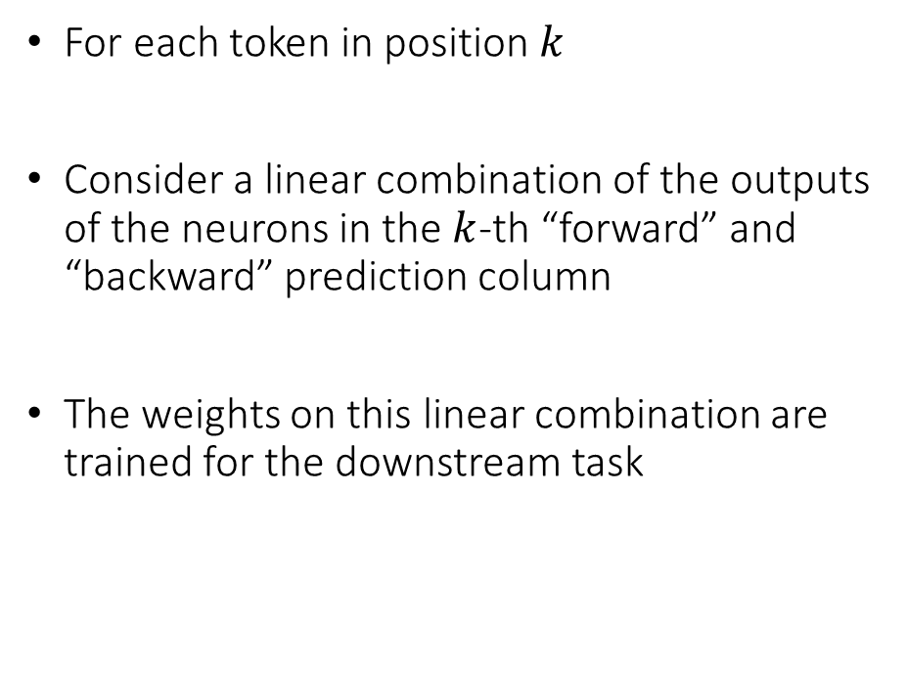
Embeddings from ELMo
For each token in position $k$
Consider a linear combination of the outputs of the neurons in the $k$-th “forward” and “backward” prediction column
The weights on this linear combination are trained for the downstream task
Downstream prediction

Slide 45
Second Generation: BERT
ELMo is very sequential and one-directional
The context of a word in the prediction is either “previous words” or “subsequent words”
Better to use context from both “directions” aka “bi-directional”
Long-range dependencies in language are hard to capture (despite LSTM)
We might want to create higher level “neighborhoods” that go beyond the local neighborhoods implicitly used in LSTM/RNN

Slide 46
Second Generation: BERT
Better to use context from both “directions” aka “bi-directional”
We might want to create higher level “neighborhoods” that go beyond the local neighborhoods implicitly used in LSTM/RNN
We need the network to also learn “neighborhood structures”
These “neighborhood structures” are known as “attention regions”
When we calculate the “context” for predicting a word we want to take into account the weighted average embedding of all the words in the attention region related to that word

Slide 47
Second Generation: BERT
Better to use context from both “directions” aka “bi-directional”
We might want to create higher level “neighborhoods” that go beyond the local neighborhoods implicitly used in LSTM/RNN
Constructing such “trainable” attention regions associated with a word is what a “Transformer” architecture does
So BERT uses Bi-directional Encoder Representations built with Transformers

Slide 48
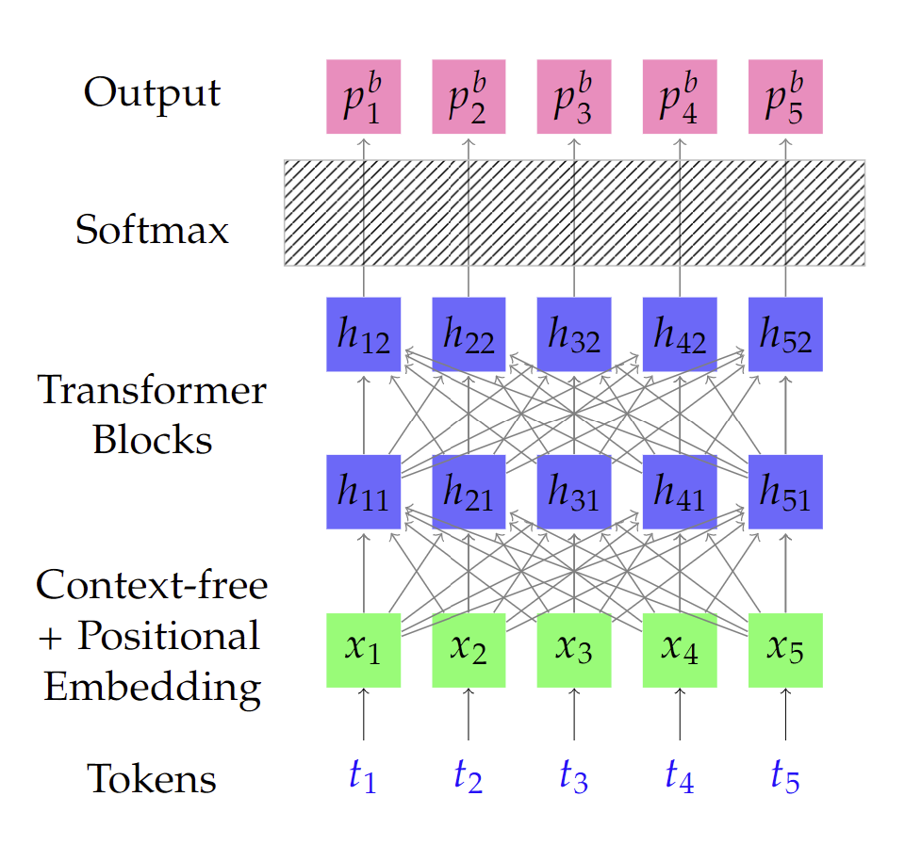
Second Generation: BERT
The parameters are trained using two language tasks
Mask: a random set of words in the document is masked and the goal is to predict them
Pair: pairs of sentences are given and the goal is to predict if one sentence follows the other
Embeddings from BERT can be done in two ways:
Outputs of the last few Transformer layers as features
Fine tune whole network to target task; append a predictor at the end of the Transformer layers

Slide 49
Third Generation: GPT (Generative Pre-Training) Family
Ideas from the auto-regressive approach of ELMo (predict next words)
With attention based encoding ideas in BERT, i.e. Transformers

Slide 50
Embeddings for Image Data

Slide 51
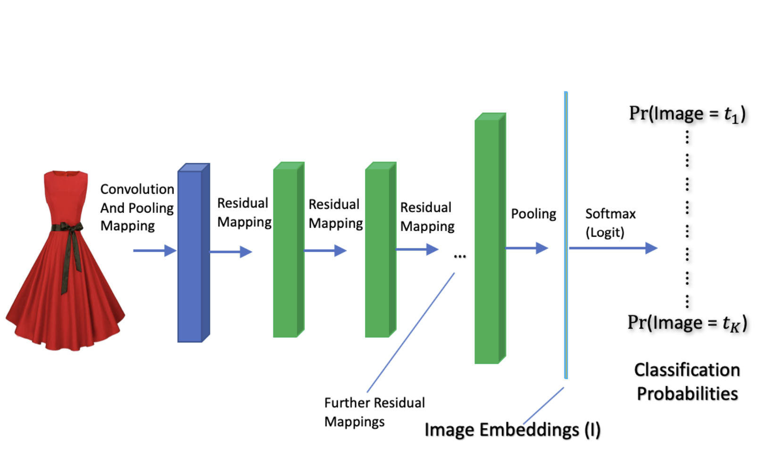
Classification Tasks and Convolutional Nets
ResNet: each block allows the input signal to also flow in-tact without a non-linearity

Slide 52
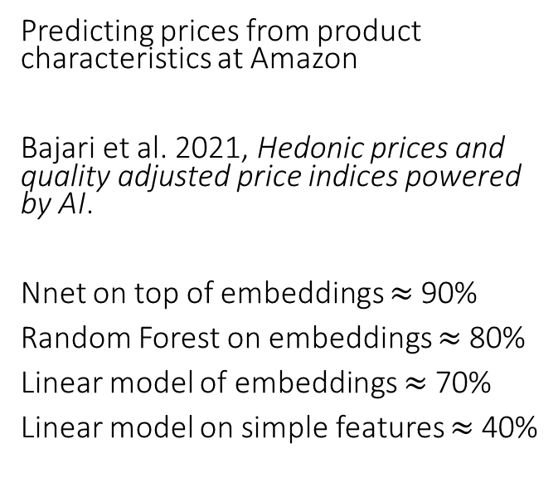
Embeddings for Price Prediction
Predicting prices from product characteristics at Amazon
Bajari et al. 2021, Hedonic prices and quality adjusted price indices powered by AI.
Nnet on top of embeddings $≈$ 90%
Random Forest on embeddings $≈$ 80%
Linear model of embeddings $≈$ 70%
Linear model on simple features $≈$ 40%
Example Notebook: BERT Features in Causal Effect Estimation of Price Elasticities Notebook

